Slide 1
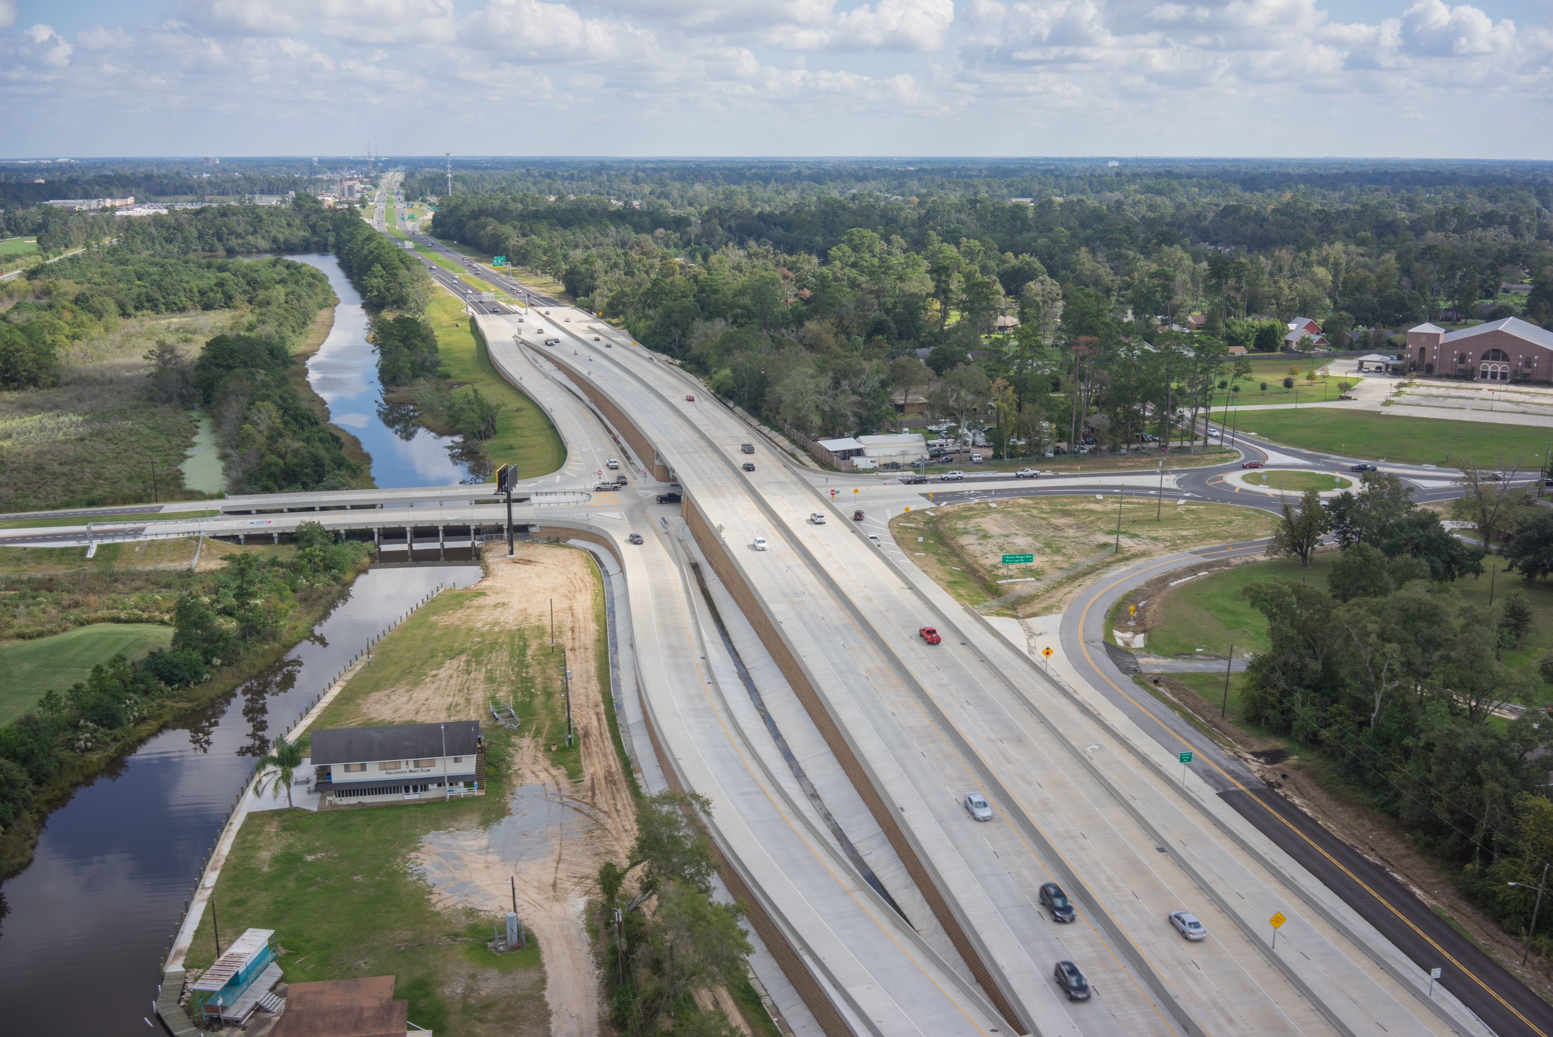
2016 Southeastern Transportation Geotechnical Engineering Conference
Cove Lane Interchange (I-210 & Cove Lane)
Lake Charles, Louisiana
*Photo by GeoEngineers

Slide 2
Project Description
Construct a new interchange at I-210 and Cove Lane in Lake Charles, Louisiana. Goal was to raise I-210 and extend Cove Lane from a new roundabout at West Prien Lake Road and connect with a new public roadway running below I-210 to the new Golden Nugget Casino.
Ultra fast track schedule; from bid award to completion was to be less than 2 years.

Slide 3
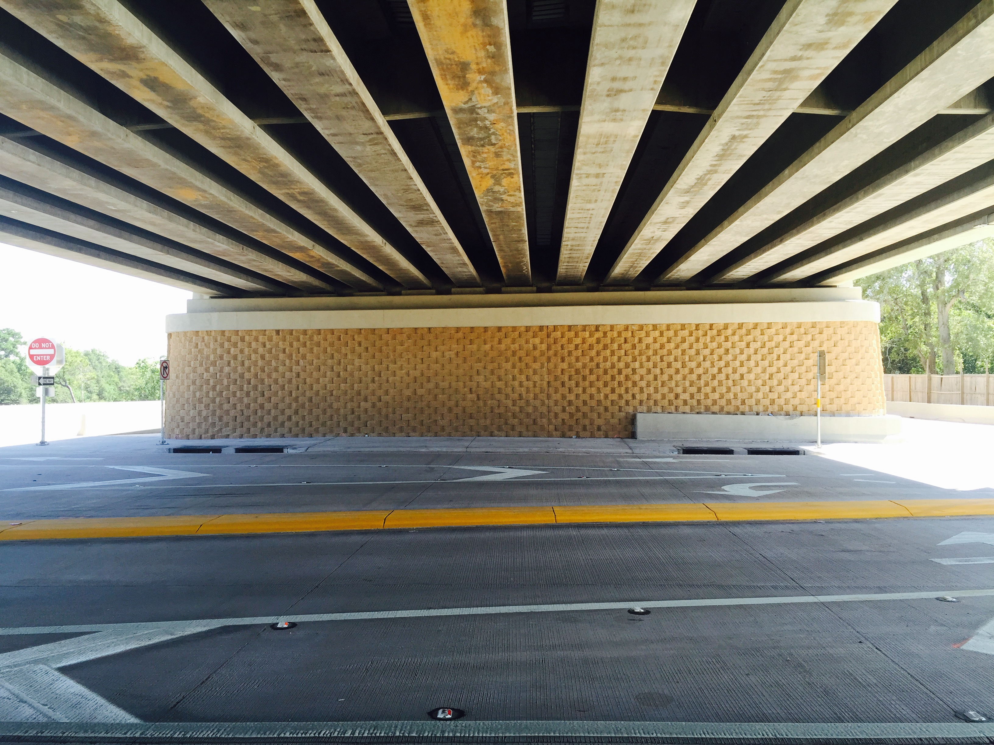
Project Team
Louisiana DOTD
DOTD Consulting Engineer – Stantec Consulting Services, Inc.
DOTD Geotechnical Engineer – GeoEngineers
General Contractor / MSEW Contractor – Johnson Bros. Corp.
MSEW Supplier – Premier Concrete Products
MSEW Engineer – Keystone Retaining Wall Systems LLC

Slide 4
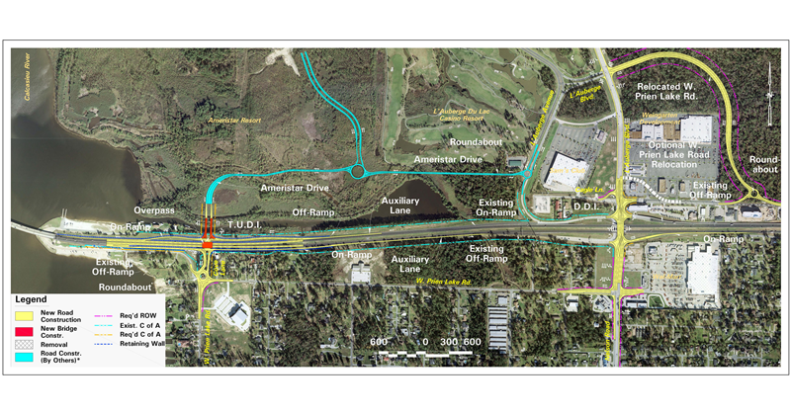
Project Map
Phase 1 of 3 of $80 million Infrastructure Improvement Master Plan.
Map shows 1.8 miles of construction of West Prien Lake Road to Cove Lane at a project cost of $38 million.

Slide 5
Project Challenges
The brand new Golden Nugget Casino prompted an immediate need for ultra fast development of infrastructure improvements.
Construction methods needed to meet the demands of an aggressive construction schedule.
Widely variable subsurface geology due to historical meandering of Calcasieu River.
  Soils varied from over-consolidated Pleistocene clay to soft alluvial deposits.
Significant stability and settlement issues (feet) related to the geologic profile
Design a ground improvement system that can fit the accelerated construction schedule.
Reinforced zone material sourcing
  LADOTD requires that MSEW reinforced fill meet 34° friction angle.
  Louisiana sands typically only meet 30° friction angle.

Slide 6
Project Challenges
Significant Geotechnical Evaluation Required by GeoEngineers
  128 Explorations
    43 drilled soil borings
    85 cone penetrometer tests
    Depths 20 to 120 Feet
  Associated Laboratory Testing
  Embankment Settlement Analysis
  MSE Wall Embankment Stability Analysis
  LRFD Design Analysis
  Ground Improvement Recommendation and Design
  Pavement Design
  Abutment Foundation Recommendations

Slide 7
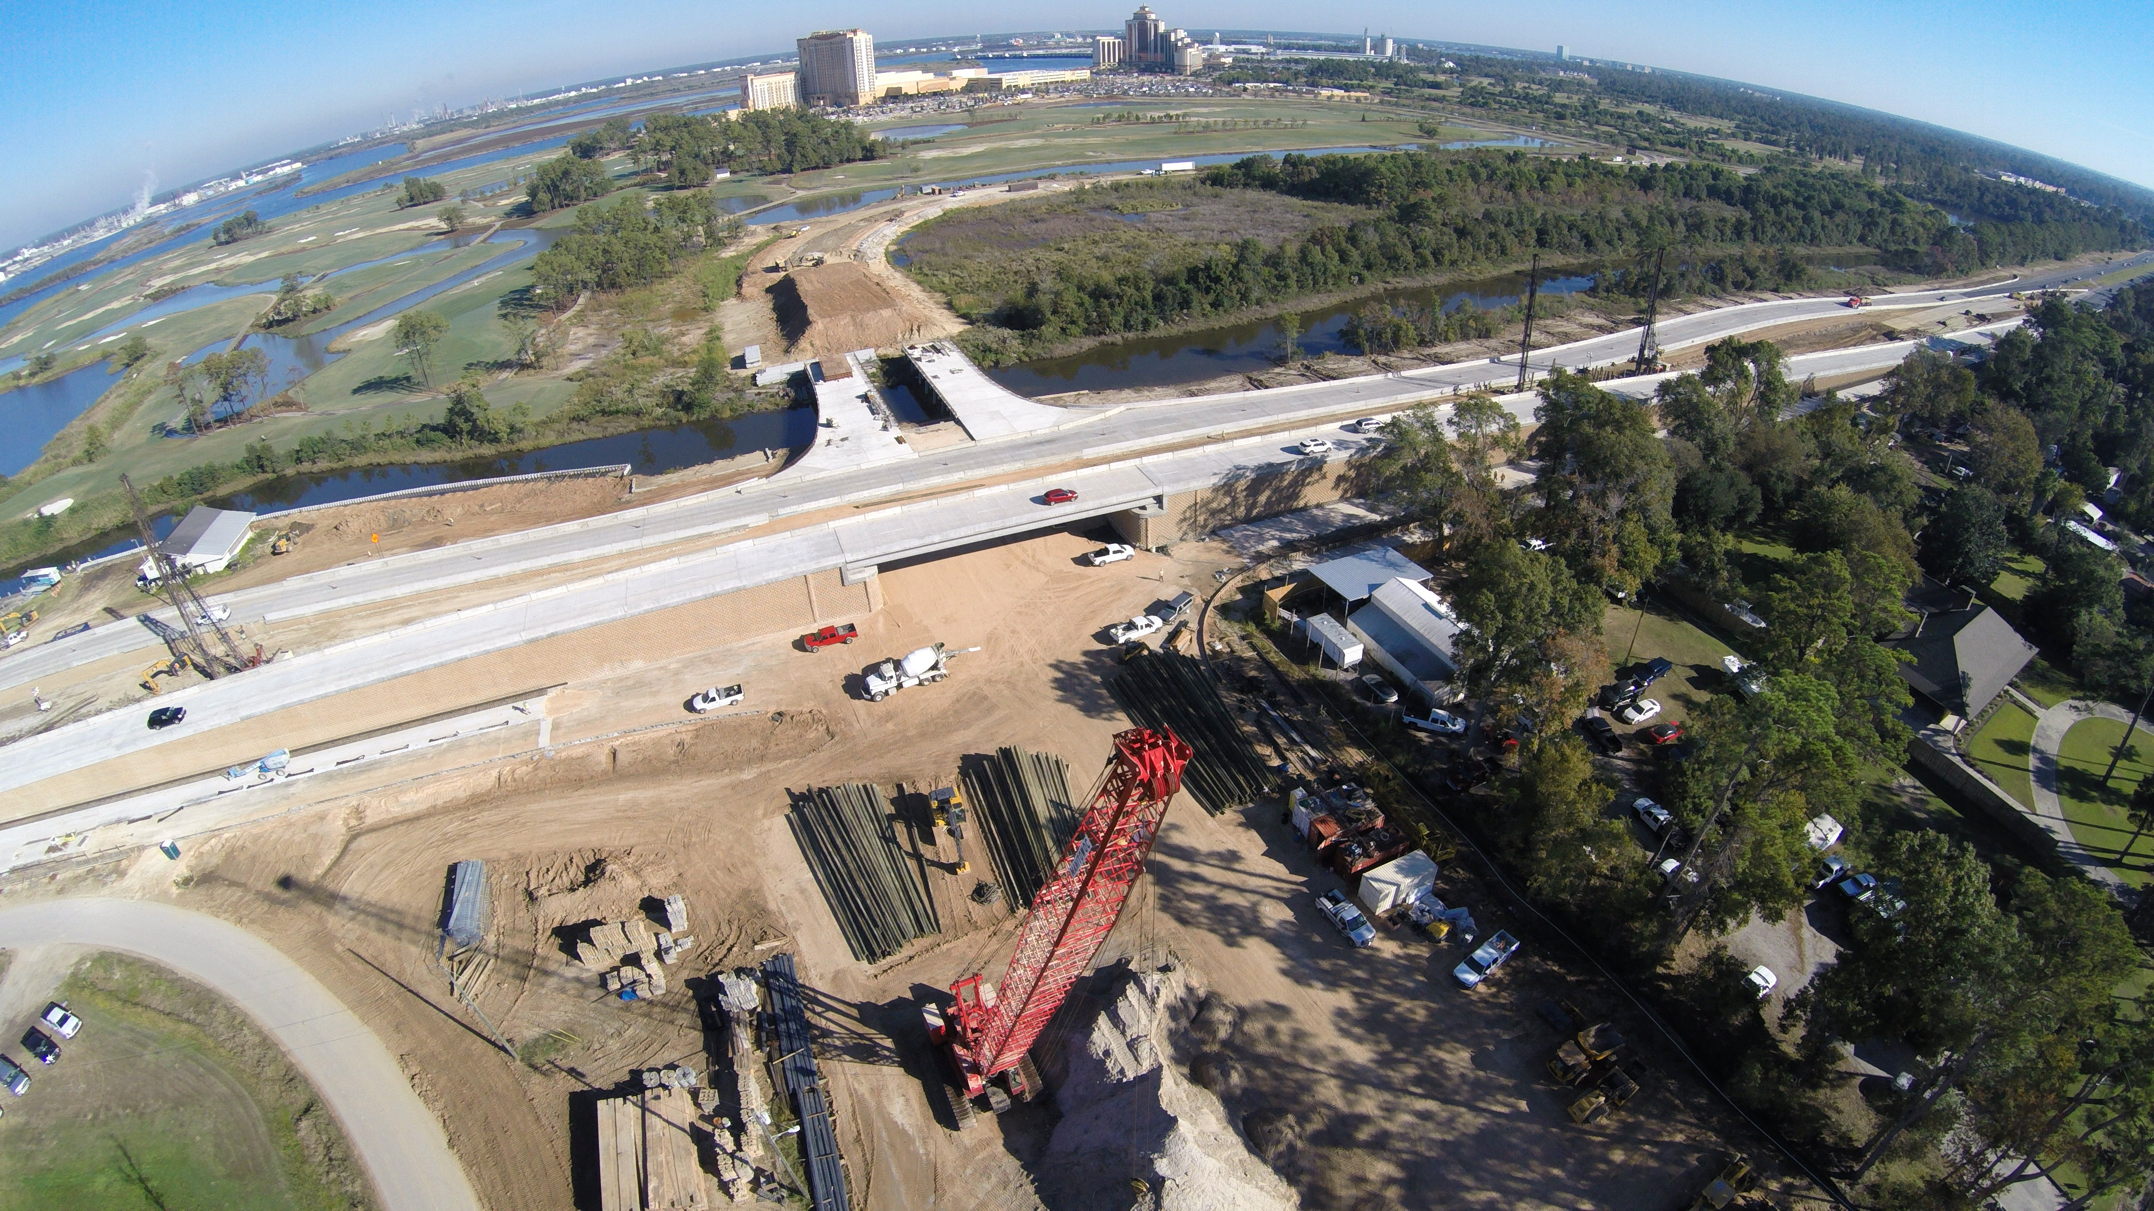
Solution: Driven Piles and Load Transfer Platform
*Photo by GeoEngineers
More than 8,000 Piles were installed.
Piles significantly reduce the settlement potential.
Installation of piles kept the project fast-tracked vs. soil surcharge methods
Site wide pile monitoring program was not feasible.
Every pile installation had to be observed.

Slide 8
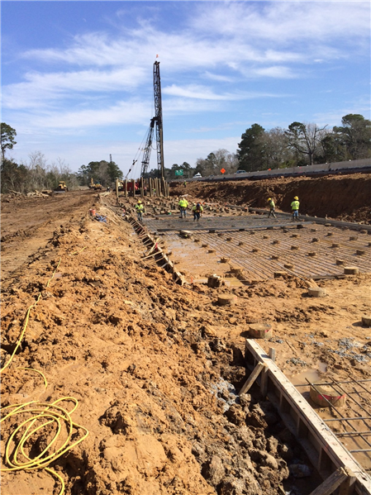
Driven Piles and Load Transfer Platform

Slide 9
Driven Piles and Load Transfer Platform
Soil Stabilization Piles
  24” Square Pre-stressed precast concrete piles (PPC) used to support I-210 bridge abutments
  Treated Timber piles used to support the approach sections
  Driven to refusal in the lower dense sand. Must be driven a minimum 5’ into sand layer
    PPC piles were utilized in the bridge abutment zone
  Lower dense sand layer approximately 50 to 60 feet below existing ground surface.
  Due to settlement issues, piles were not to be terminated into shall sand layers that overlie softer compressible clay layers.
Load Transfer Platform
  Constructed immediately above the piles to transfer embankment loads to the piles and minimize differential settlement between the rigid piles and the interstitial soft soil.
  4,000 psi concrete and 60 ksi reinforcing steel
  Variable thickness
  Drainage system designed above LTP in MSE Reinforced zone
*Geotechnical Engineering Report by GeoEngineers

Slide 10
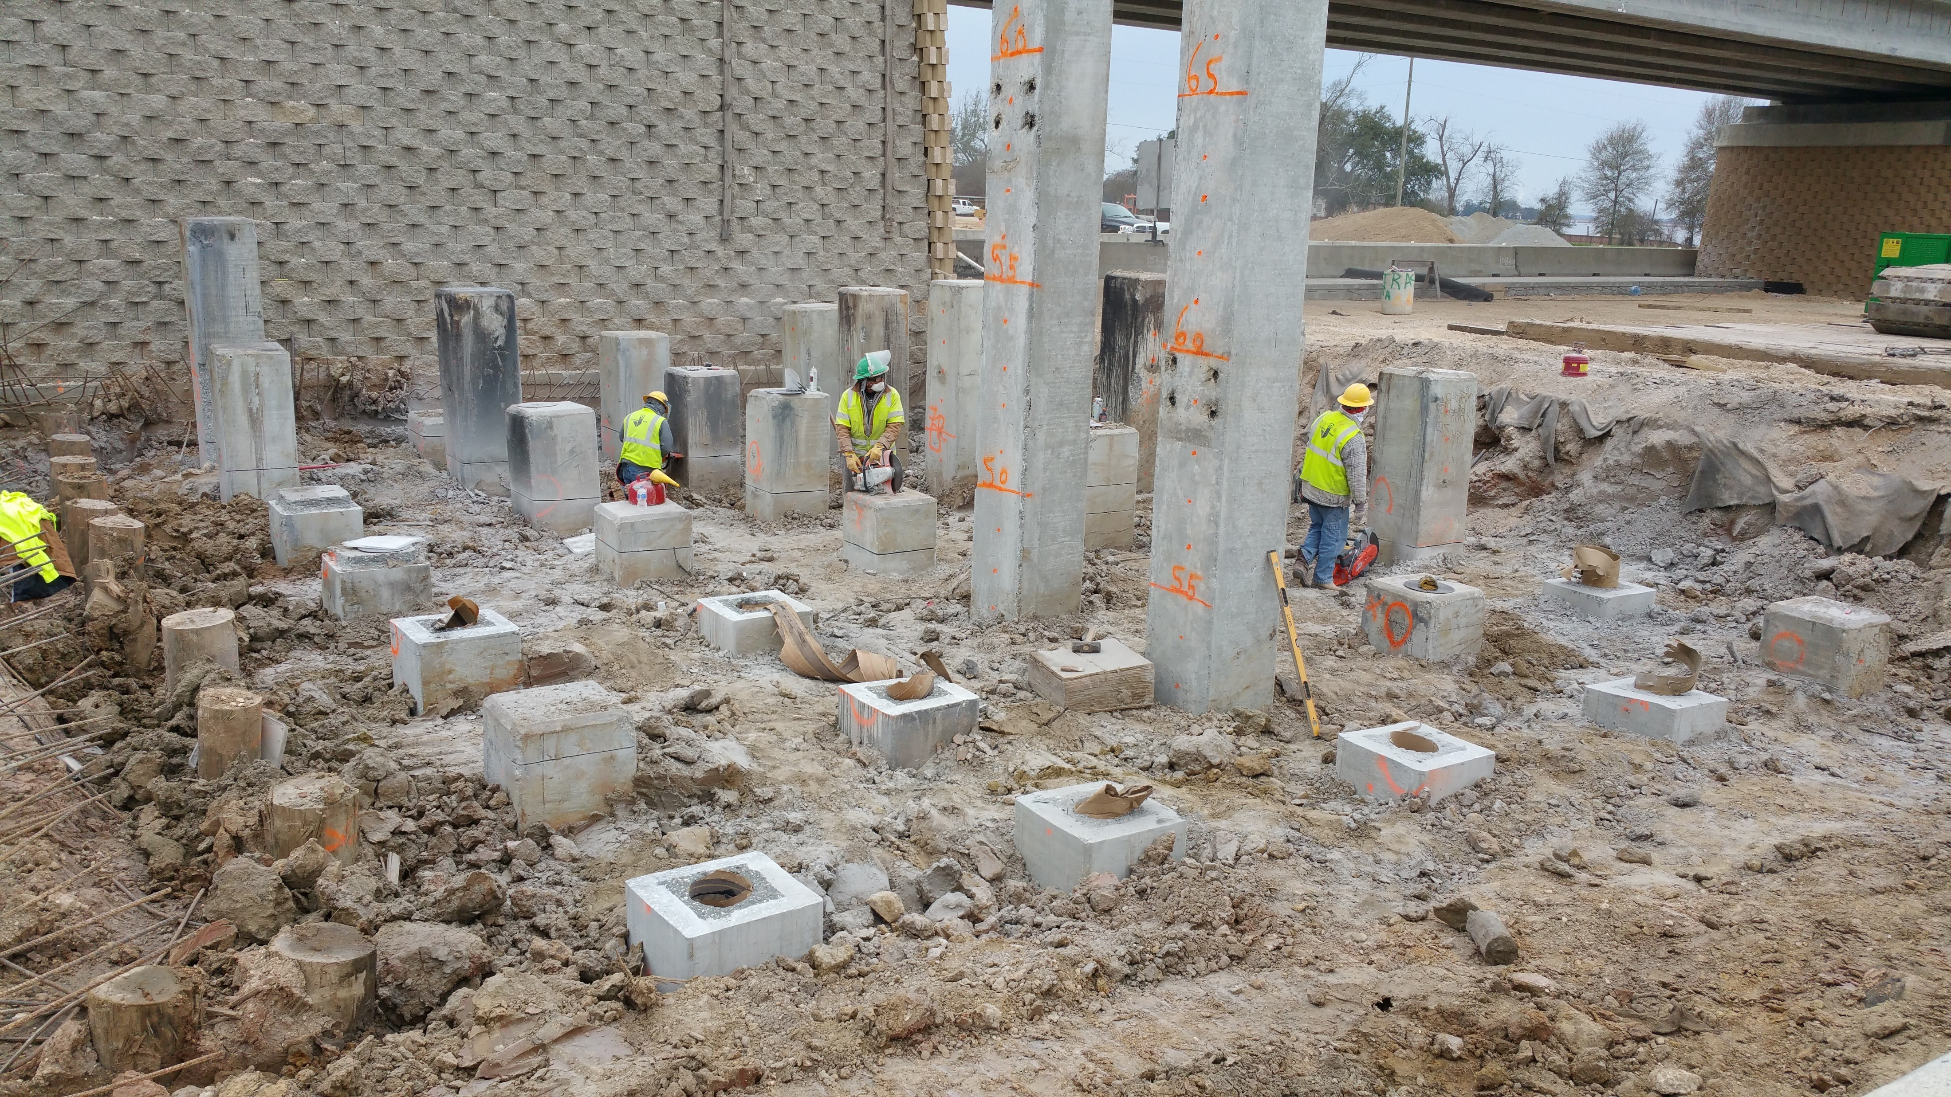
Driven Piles and Load Transfer Platform
*Photo by GeoEngineers

Slide 11
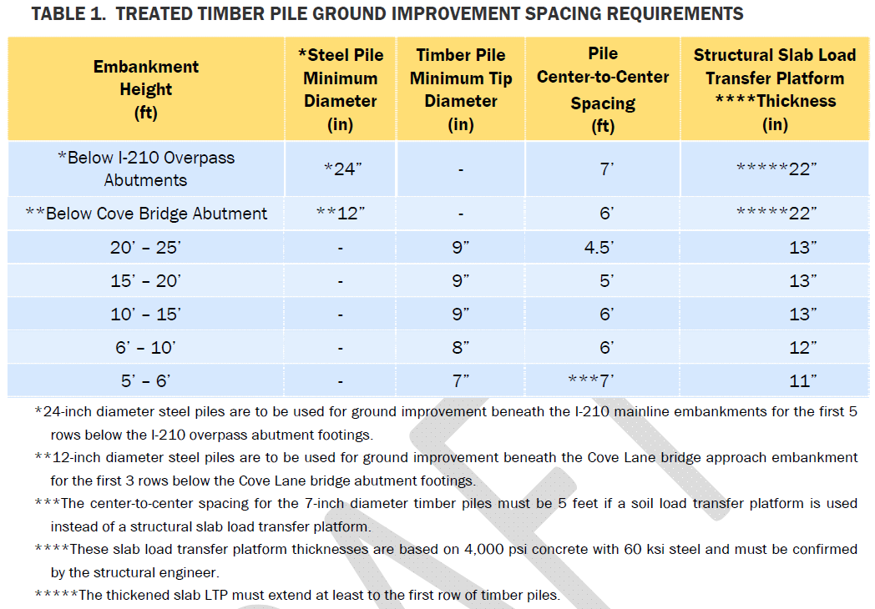
Driven Piles and Load Transfer Platform
*Geotechnical Engineering Report by GeoEngineers

Slide 12
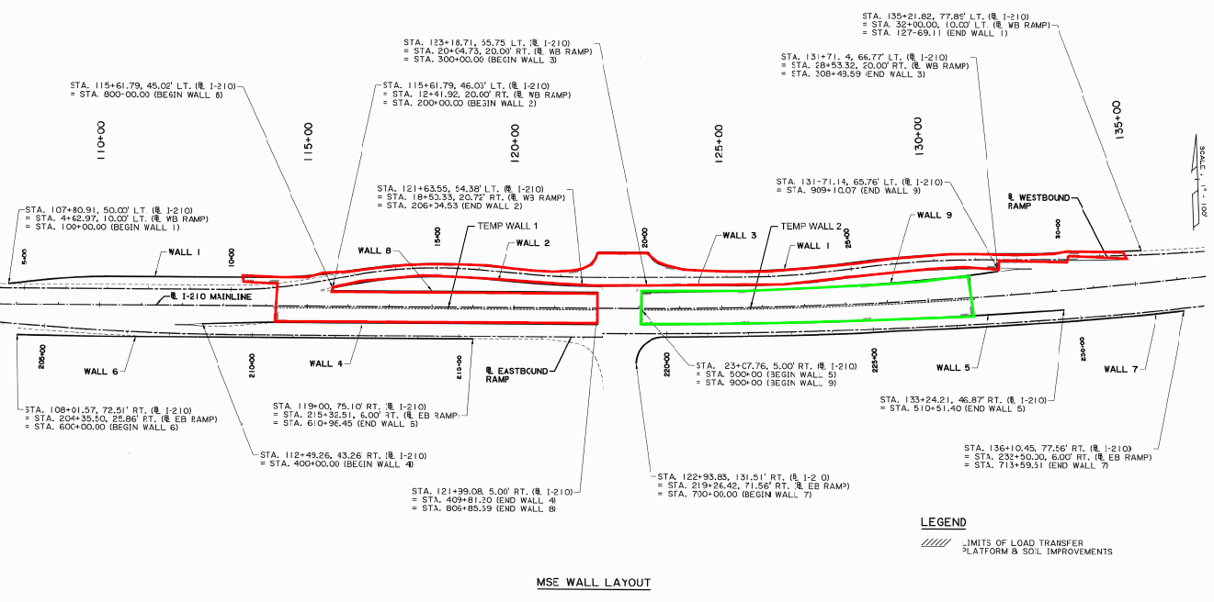
Construction Phasing

Slide 13
Project Construction Phasing
Phase 1
  Drive Soil Stabilization Piles and Construct Load Transfer Platform (LTP) for I-210 WB Ramp and WB Diversion
  Begin Construction of MSE Walls 1, 2 & 3 which support the westbound ramp and frontage road, also includes northbound Cove Lane bridge.
Phase 2
  Divert Traffic to WB Ramp and WB Diversion
  Demolish EB I-210 and Cove Lane Exit Ramp.
  Drive Soil Stabilization Piles and construct Load Transfer Platform for EB lanes of I-210.
  Construct MSE Walls 4,5,6, 7 and temporary walls. Walls 4 & 5 were the approach and abutment walls. MSE Walls 6 and 7 were EB entrance and exit ramp walls.
Phase 3
  Divert EB I-210 Traffic to new EB ramps. Divert WB traffic to new EB bridge
  Demolish WB I-210
  Drive Soil Stabilization Piles and construct Load Transfer Platform for WB lanes of I-210.
  Construct MSE Walls 8 & 9 – approach and abutment walls

Slide 14
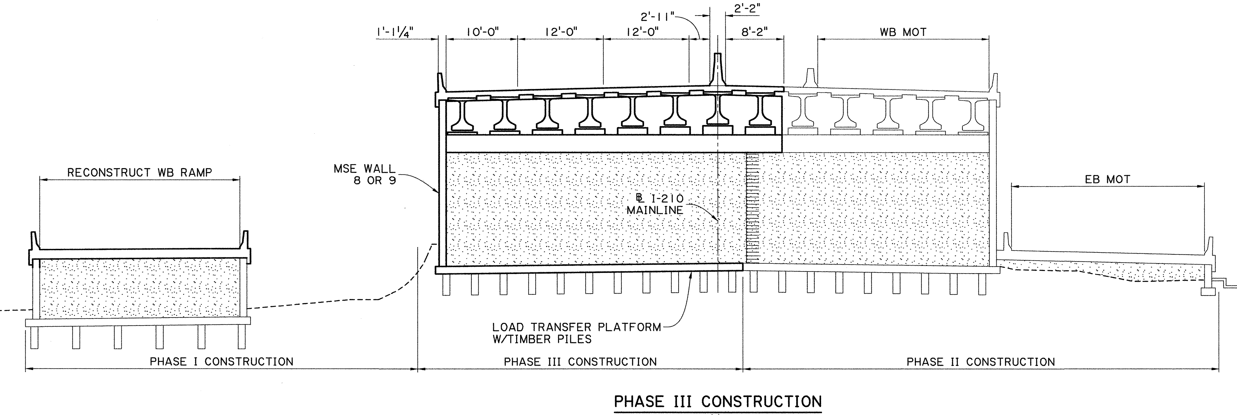
Project Construction Phasing

Slide 15
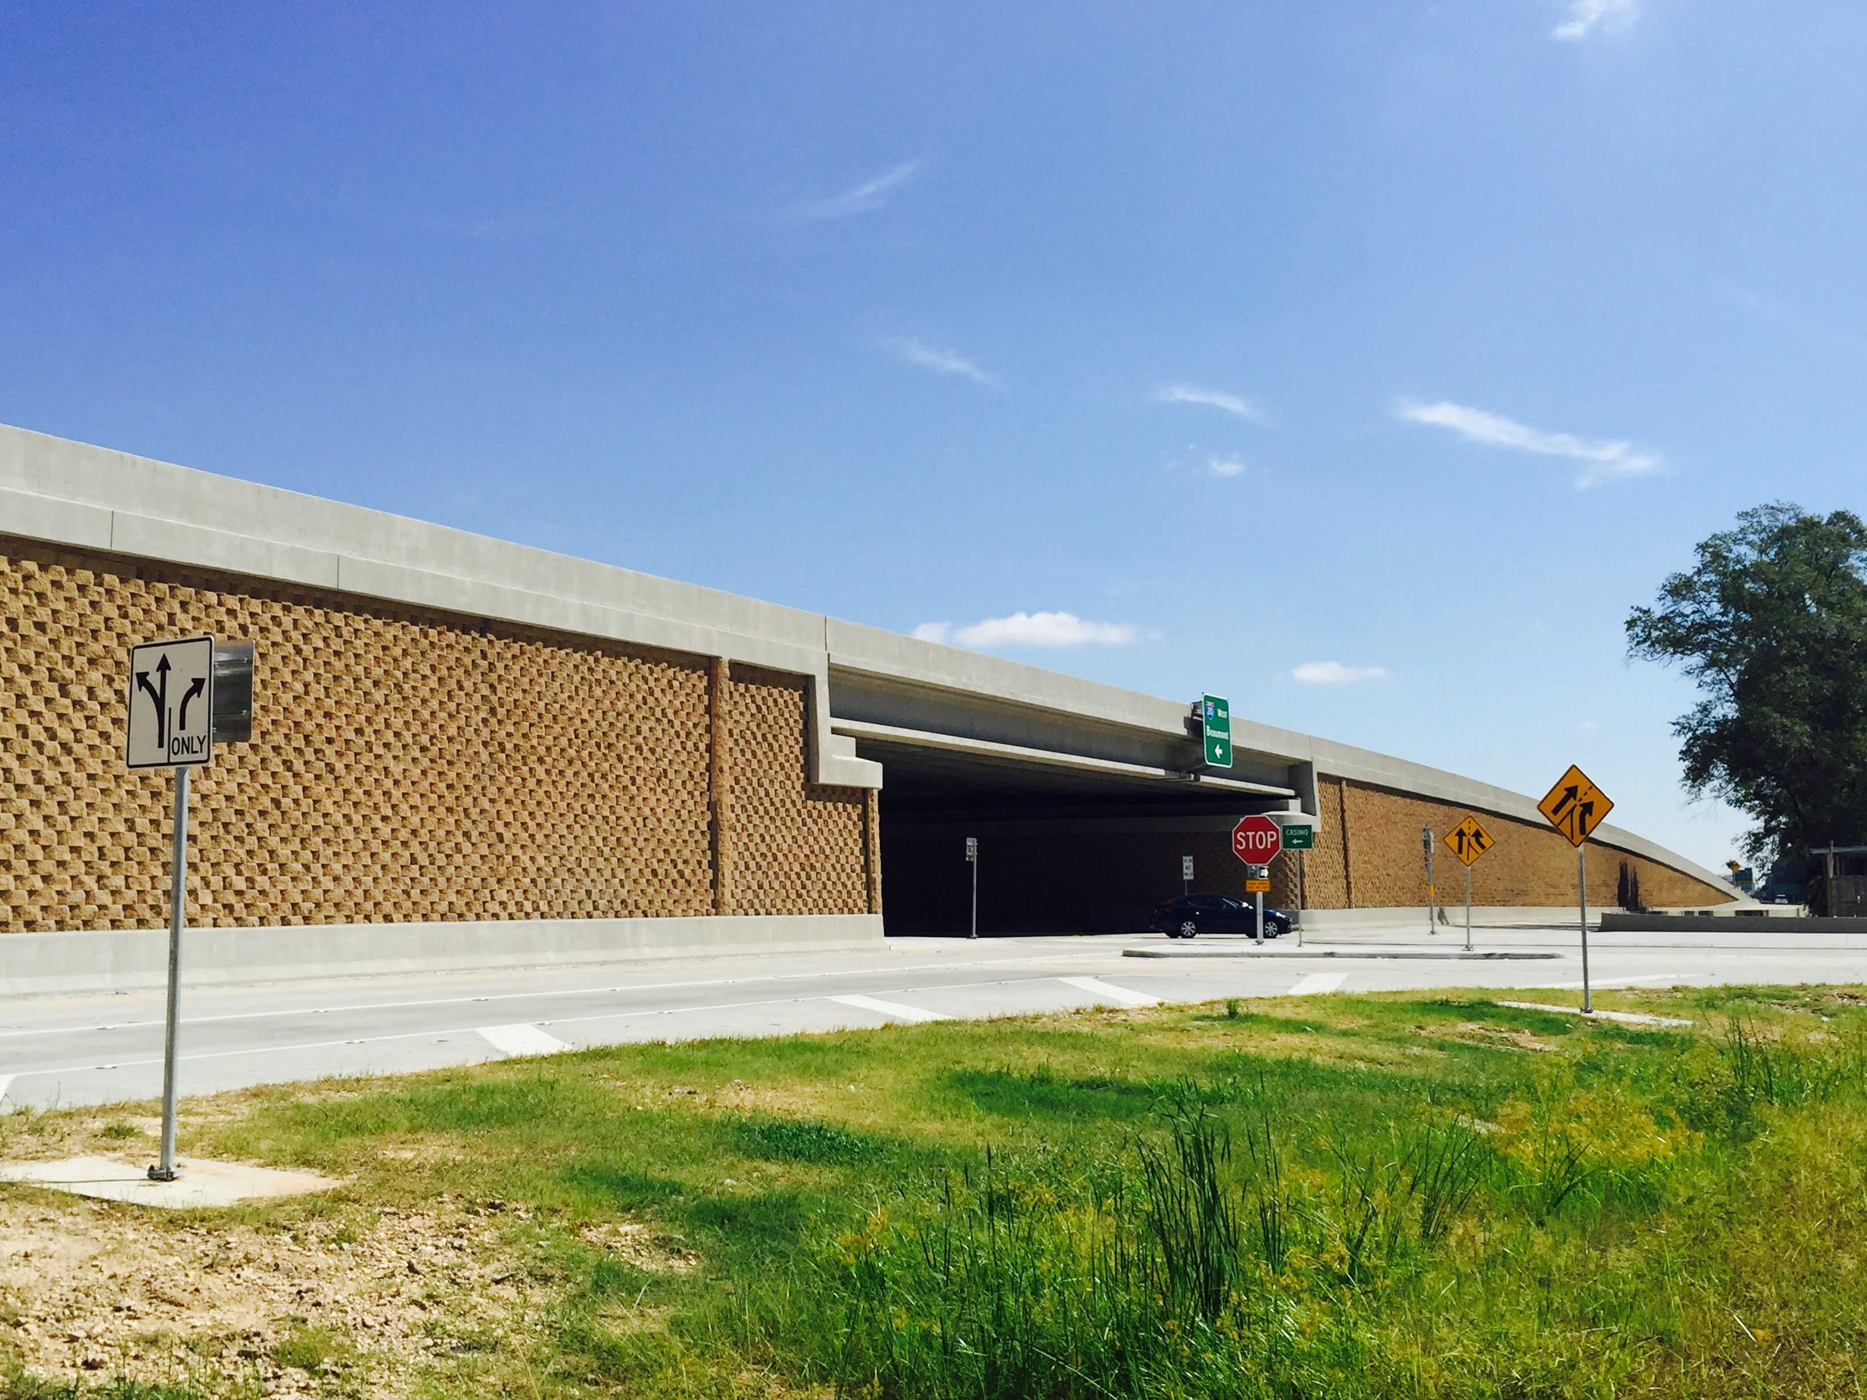
MSE Walls

Slide 16
MSE Walls
2 Different Types of MSE Walls Utilized
  Extensible Geogrid
  Inextensible Steel Reinforcement
  Walls < 8’ high did not require LTP support
Extensible Geogrid Reinforced Walls
  Polyester Geogrids
  Approach Walls, Temporary Approach Walls
  Pressure Relief Walls
  Ramp Walls
Inextensible Steel Reinforced Walls
  Galvanized Steel Wire Strips
  Load Bearing Abutment Walls and Temporary Walls at the Abutments

Slide 17
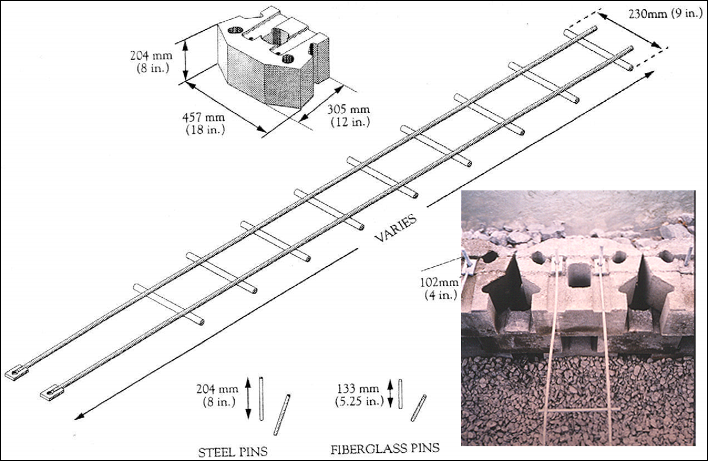
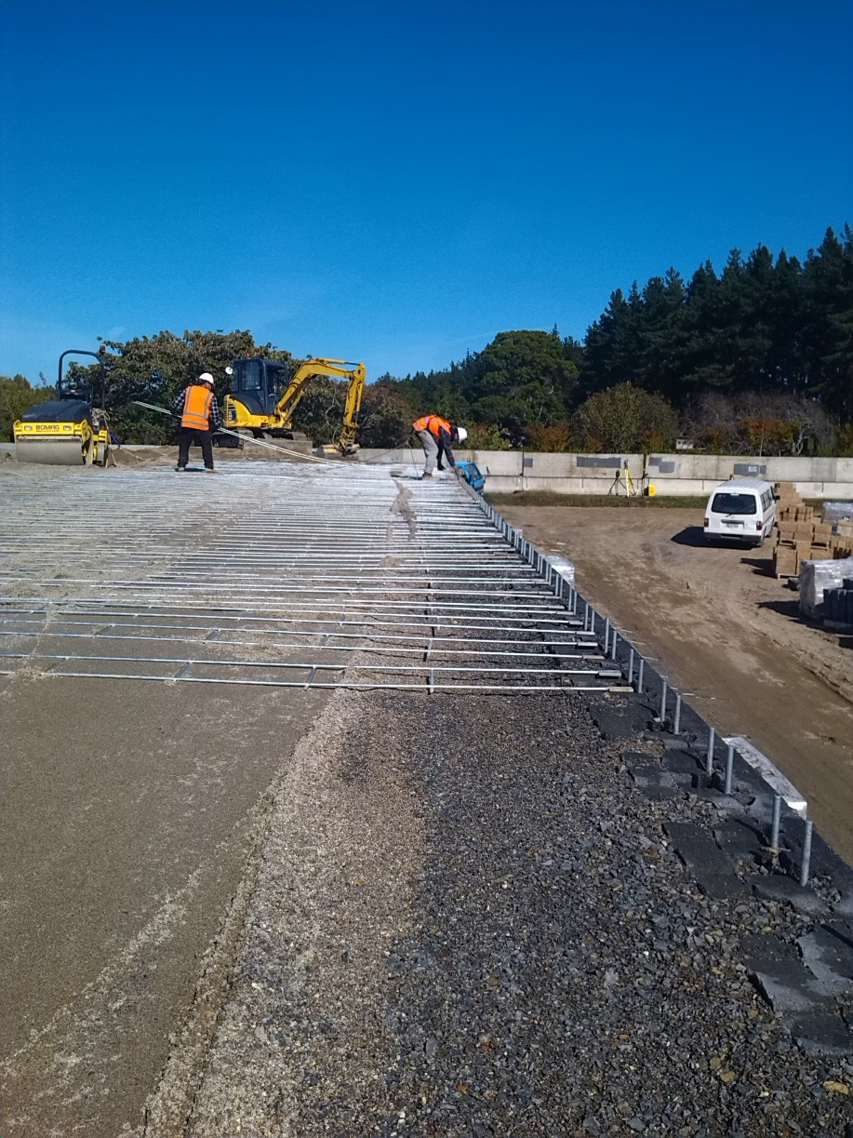
Inextensible Steel Reinforcement

Slide 18
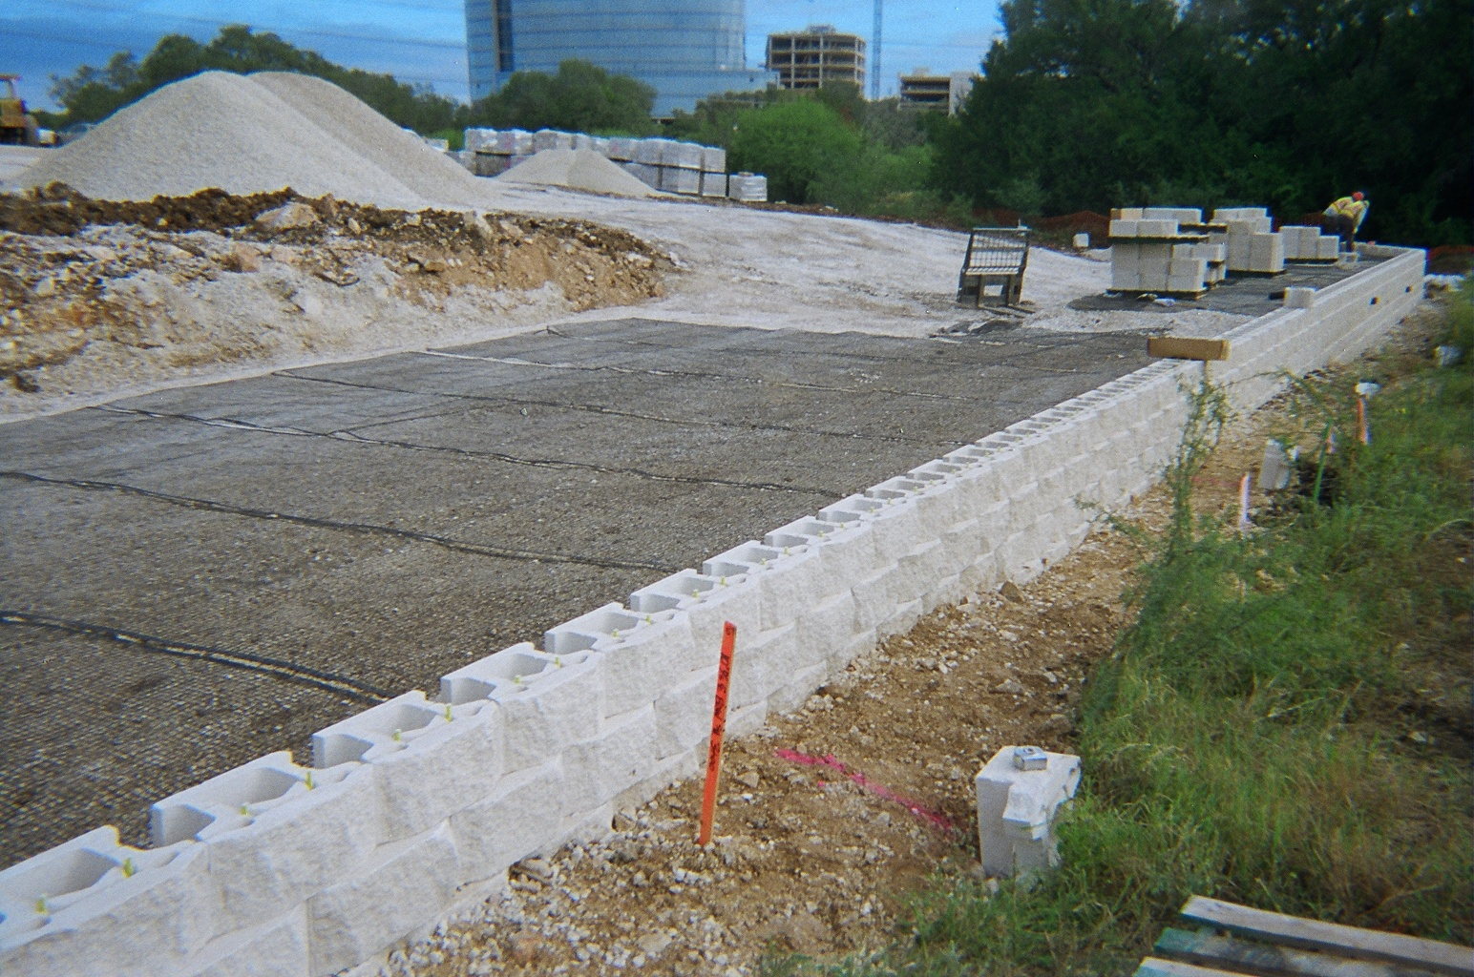
Extensible Geogrid Reinforcement

Slide 19
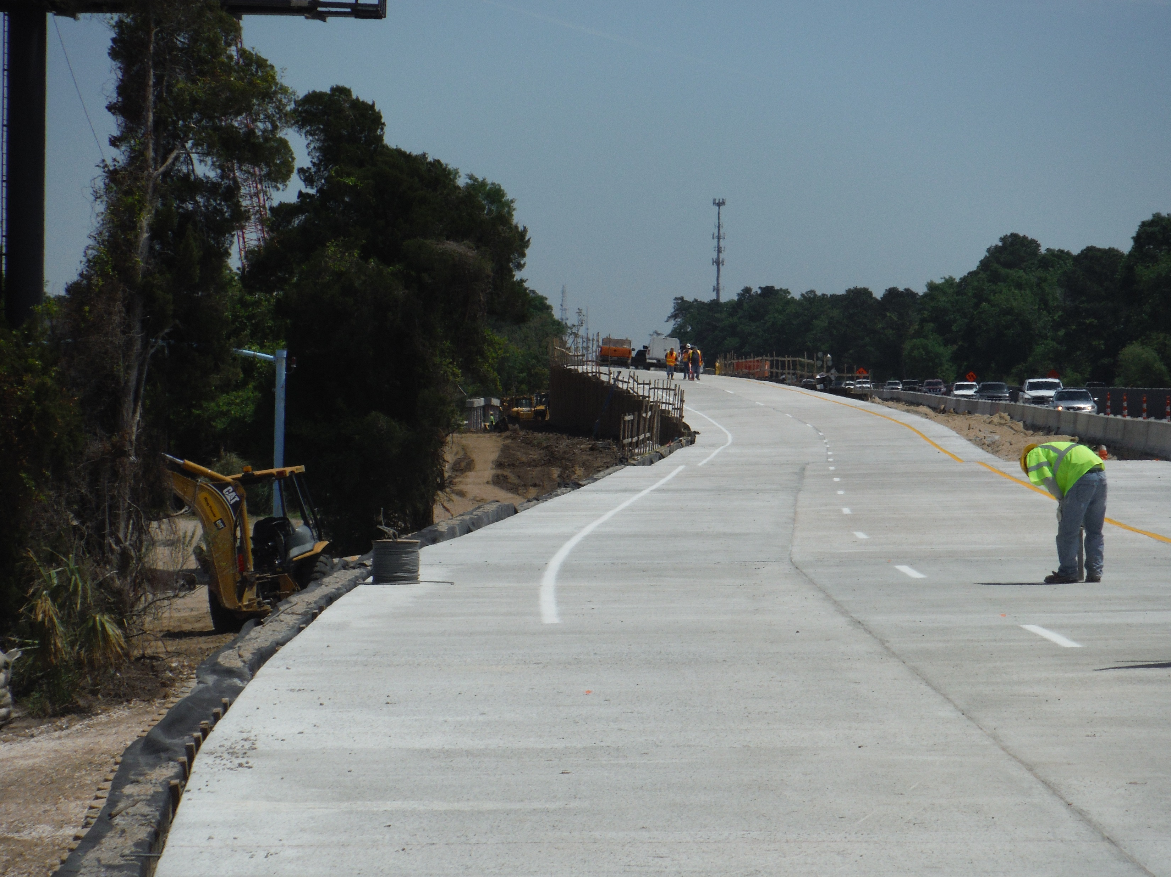
MSE Walls

Slide 20
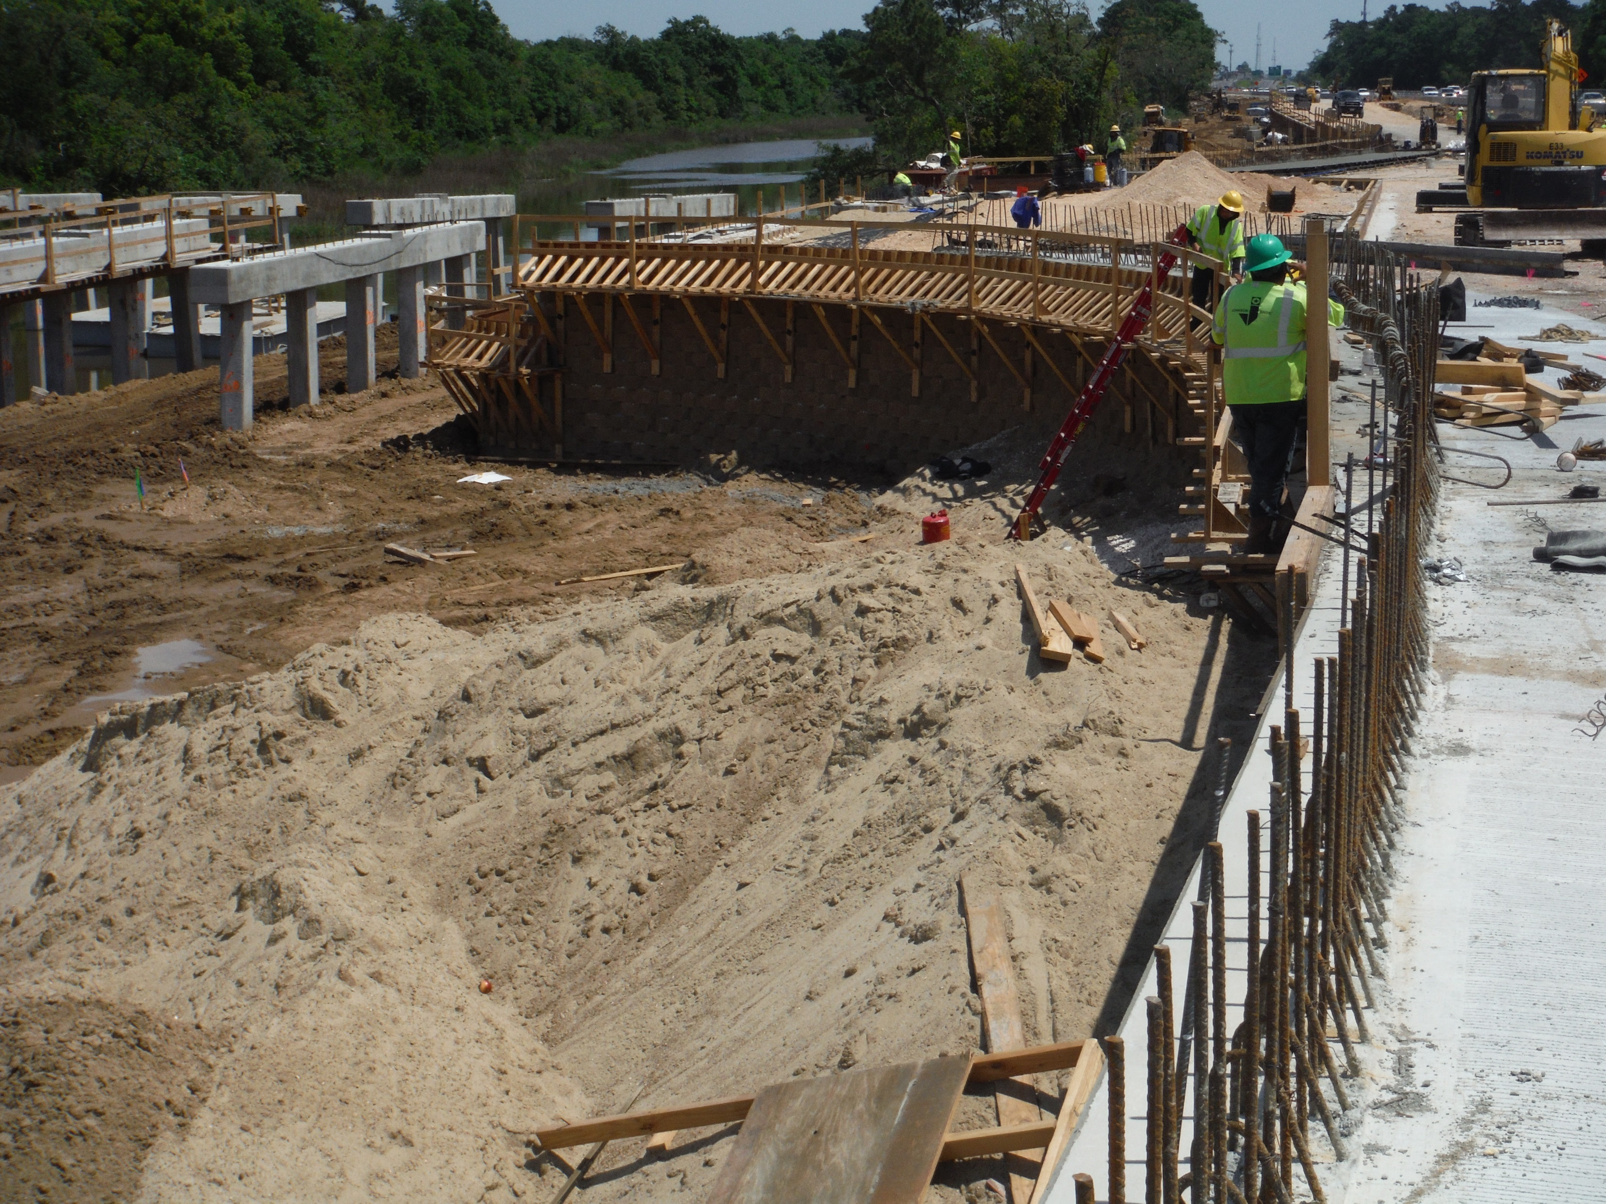
MSE Walls

Slide 21
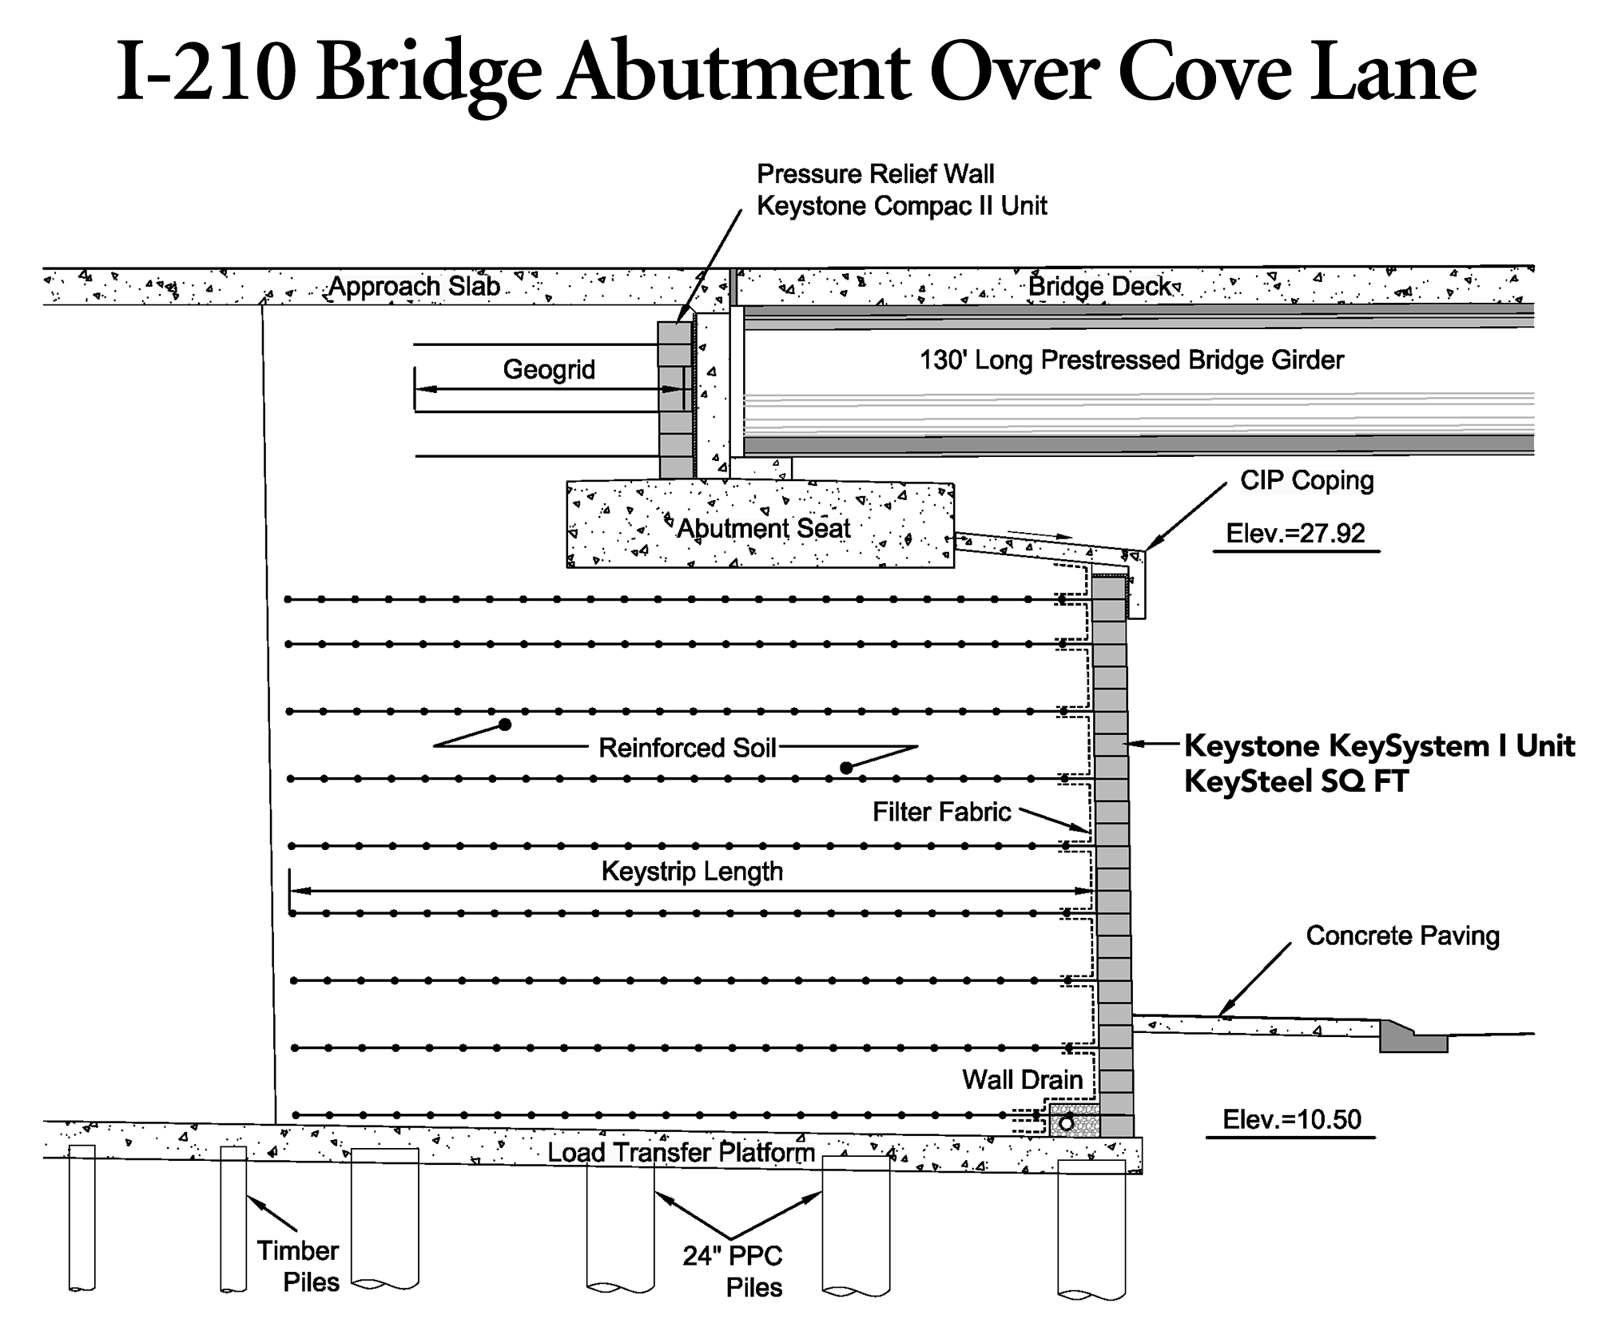
MSE Walls
The combination of 2 different systems was an integral part of designing for the structural loads at the abutment versus roadway support walls.
Additionally, their use allowed uniformity in support systems and continuity of design throughout the project phases, and addressed a compressed schedule and cost considerations.

Slide 22
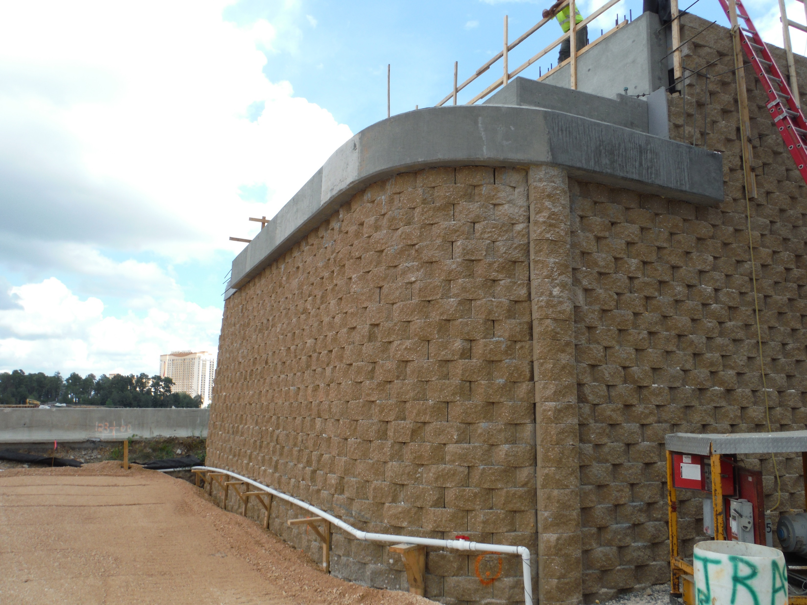
MSE Abutment Walls

Slide 23
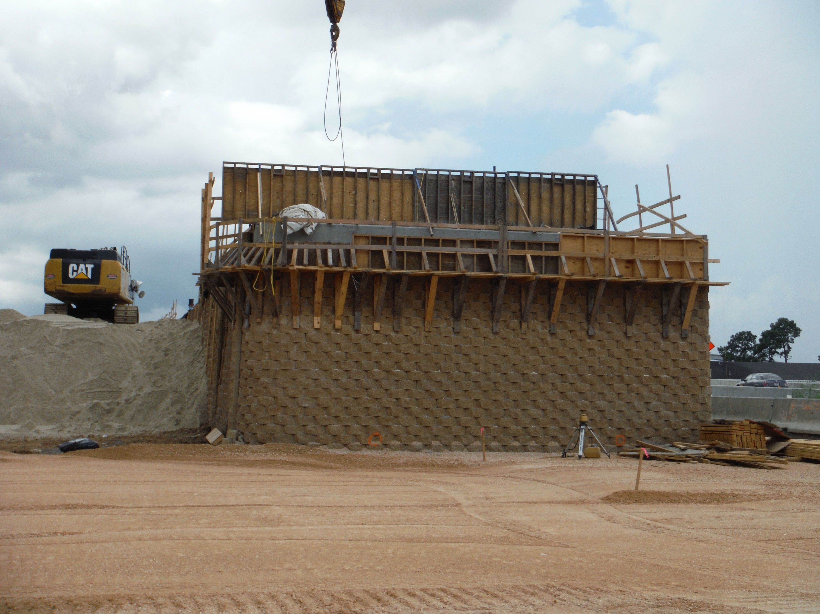
MSE Walls

Slide 24
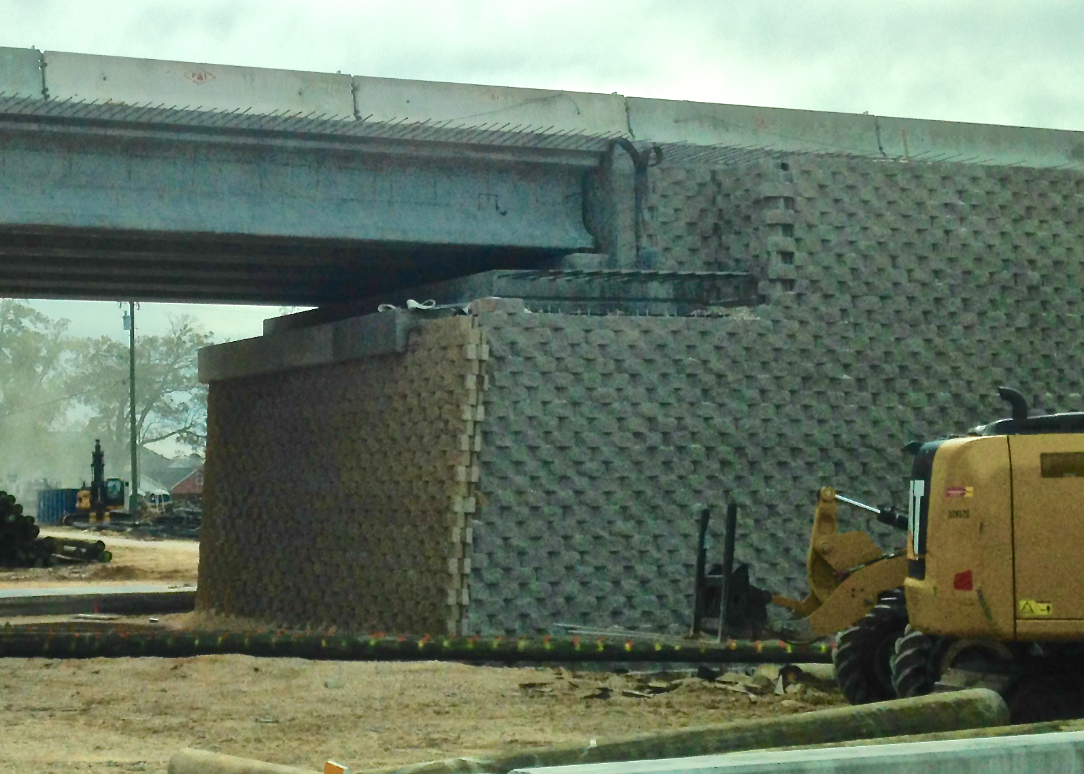
MSE Walls

Slide 25
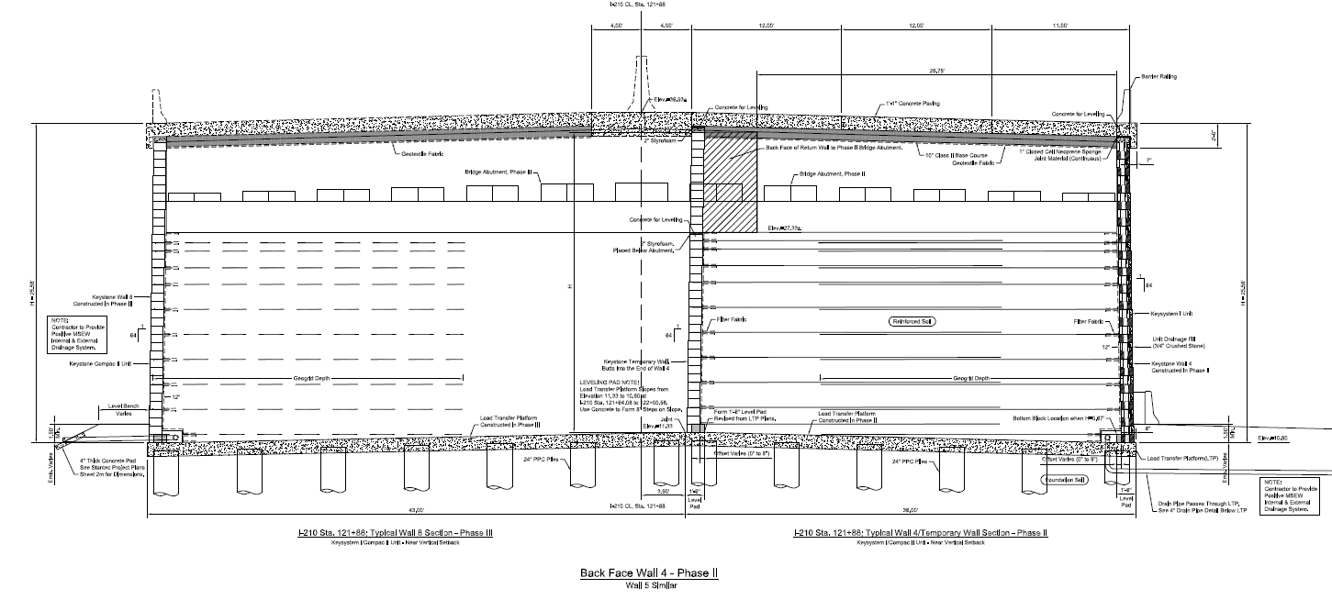
MSE Walls

Slide 26
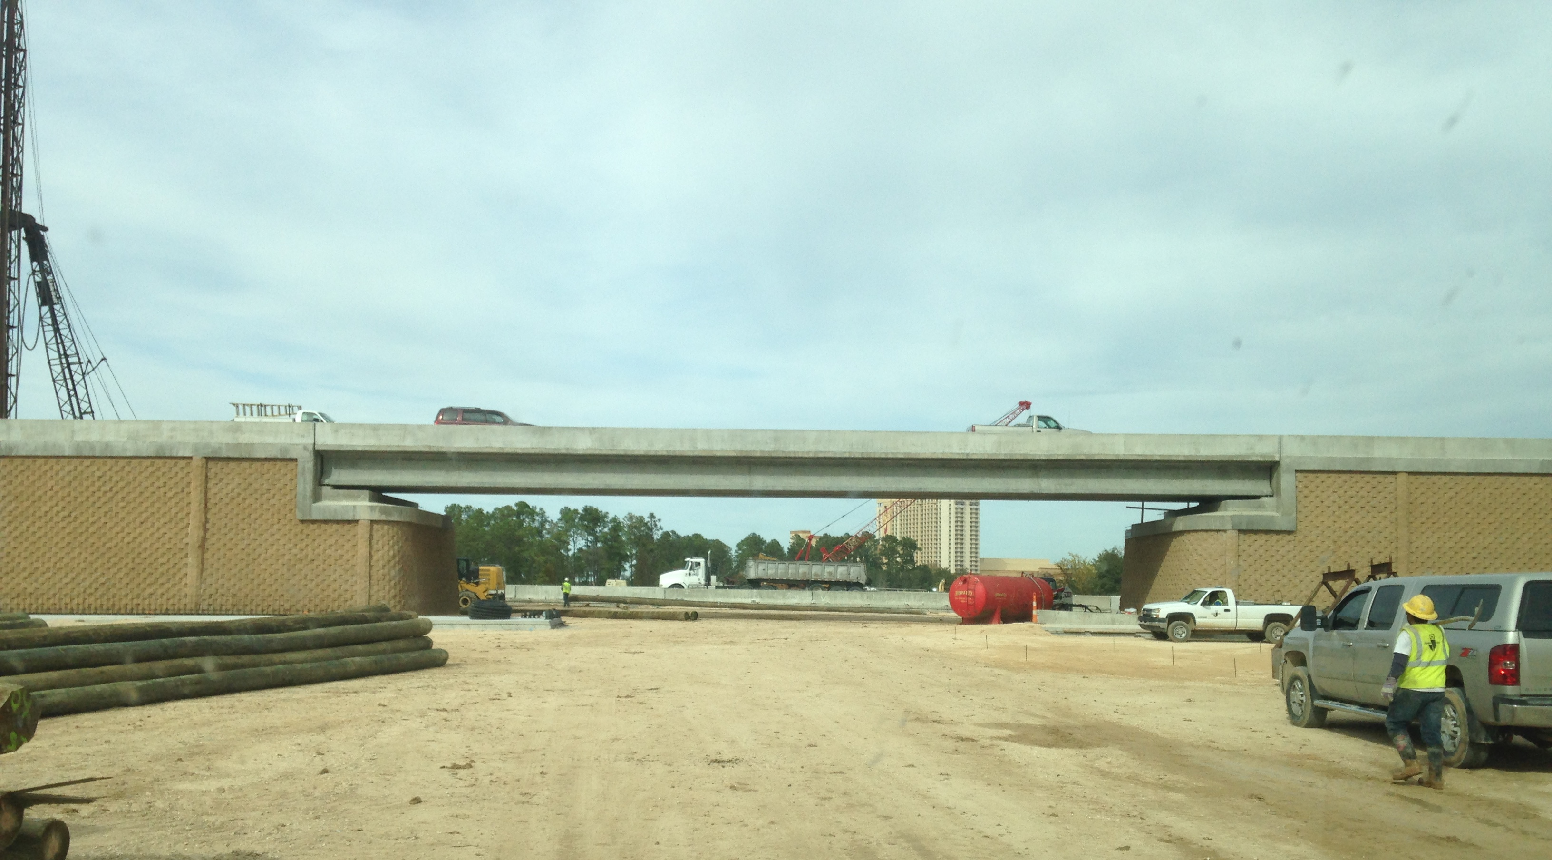
MSE Walls

Slide 27
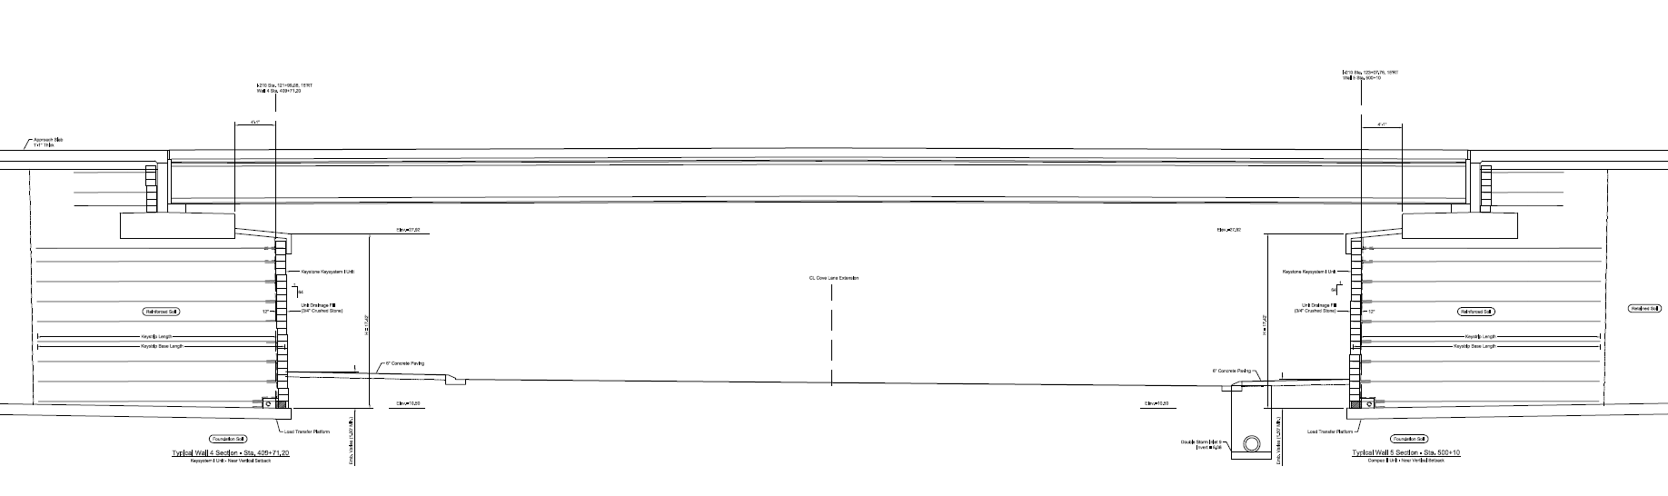
MSE Walls

Slide 28
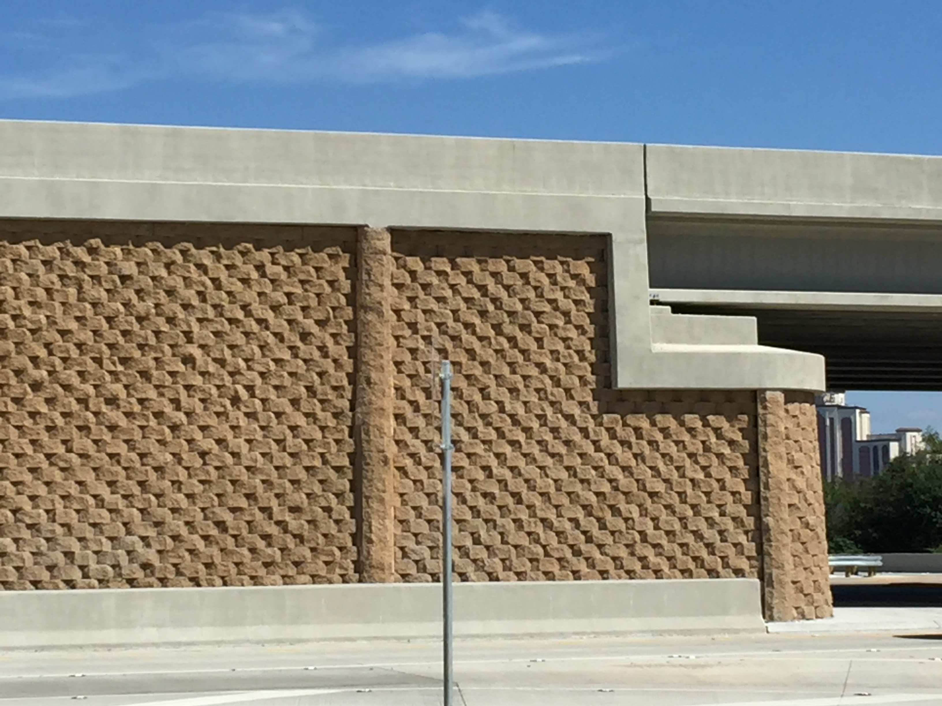
MSE Walls

Slide 29
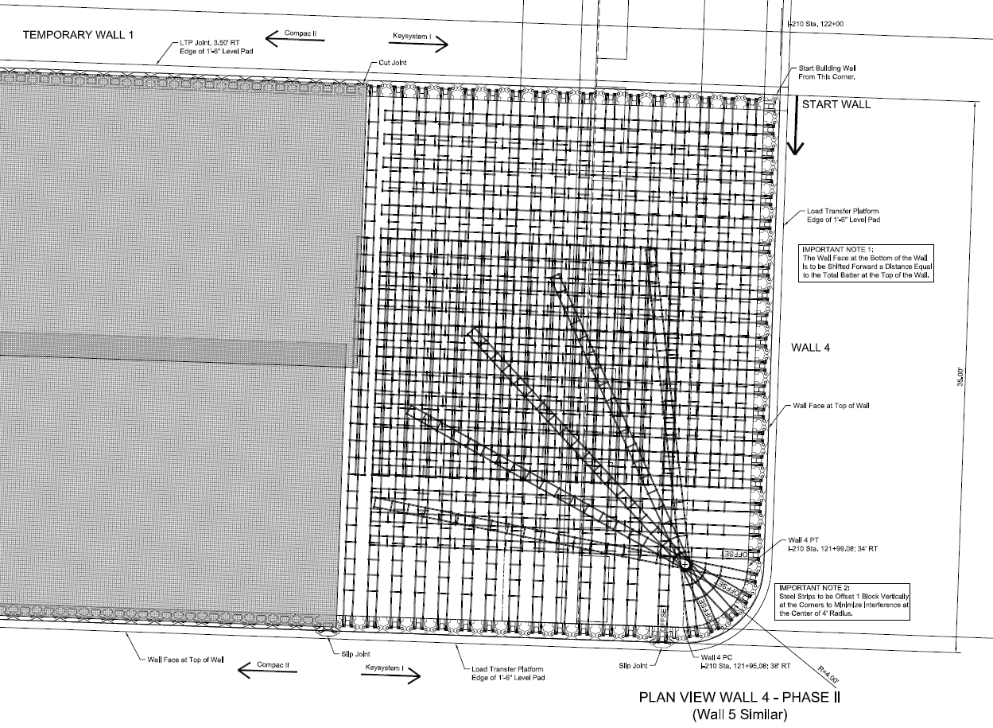
MSE Walls

Slide 30
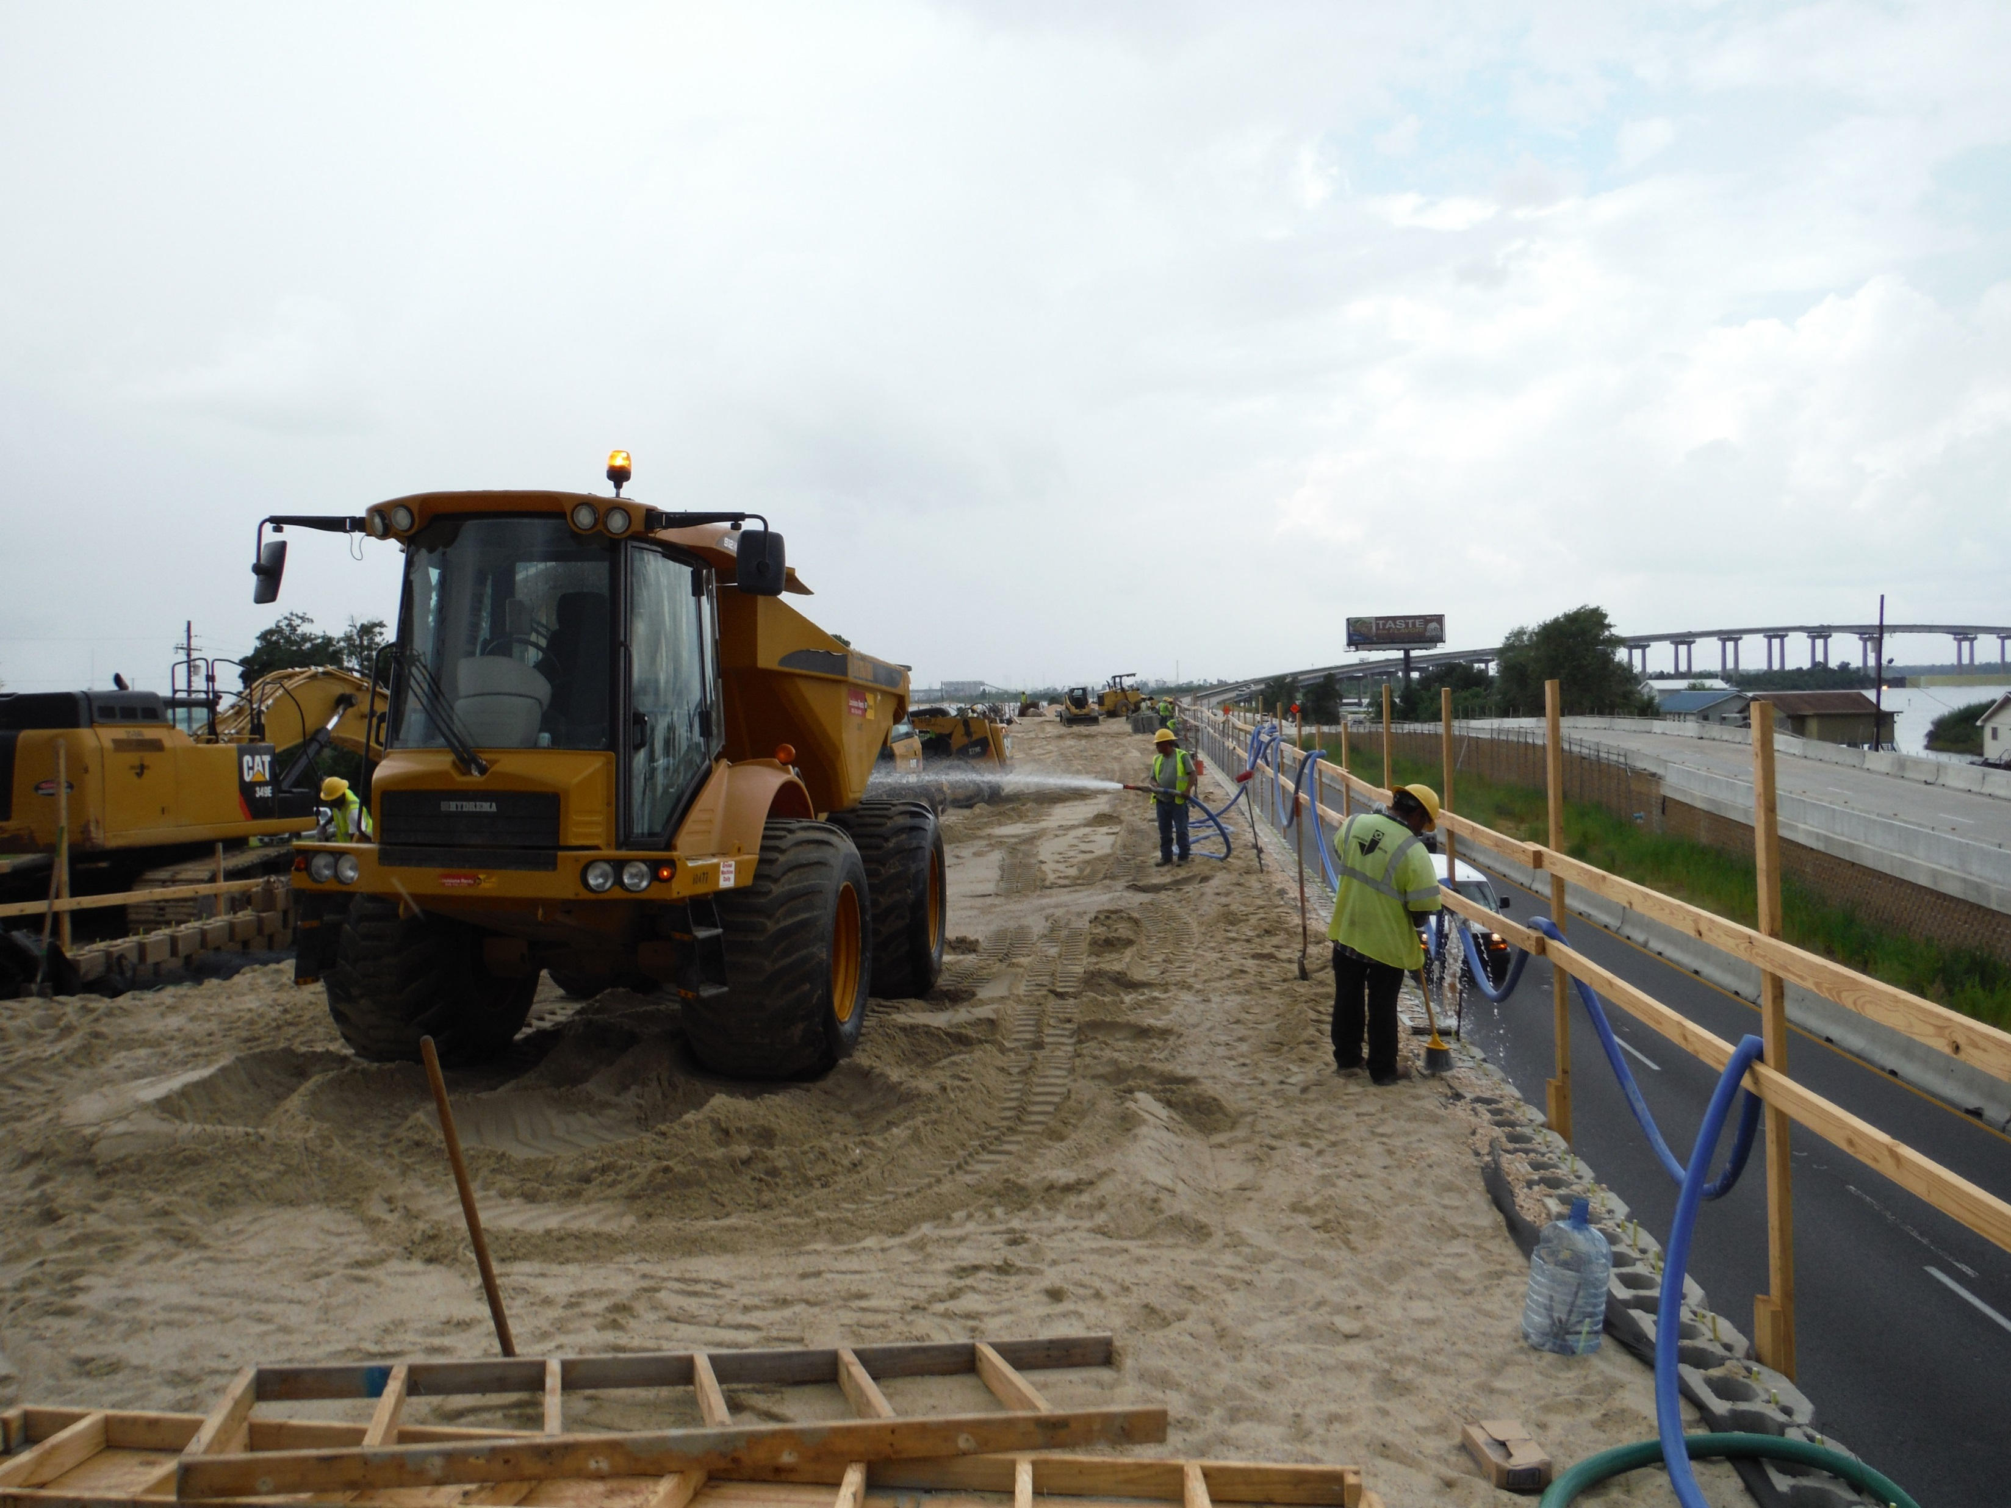
MSE Walls

Slide 31
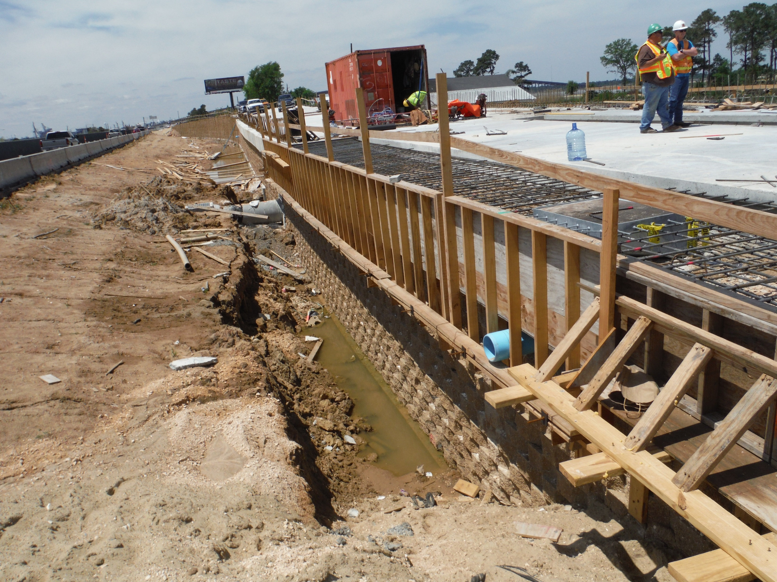
Top of MSE Walls

Slide 32
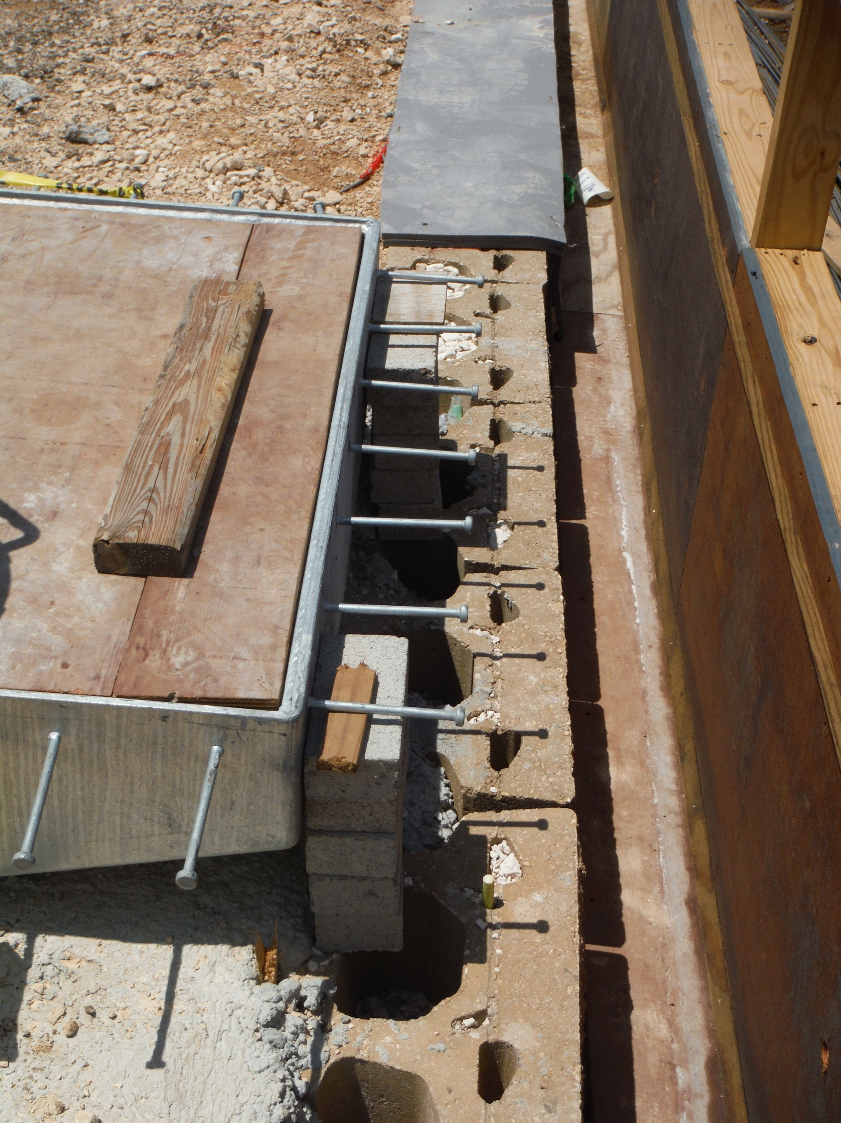
Top of MSE Walls

Slide 33
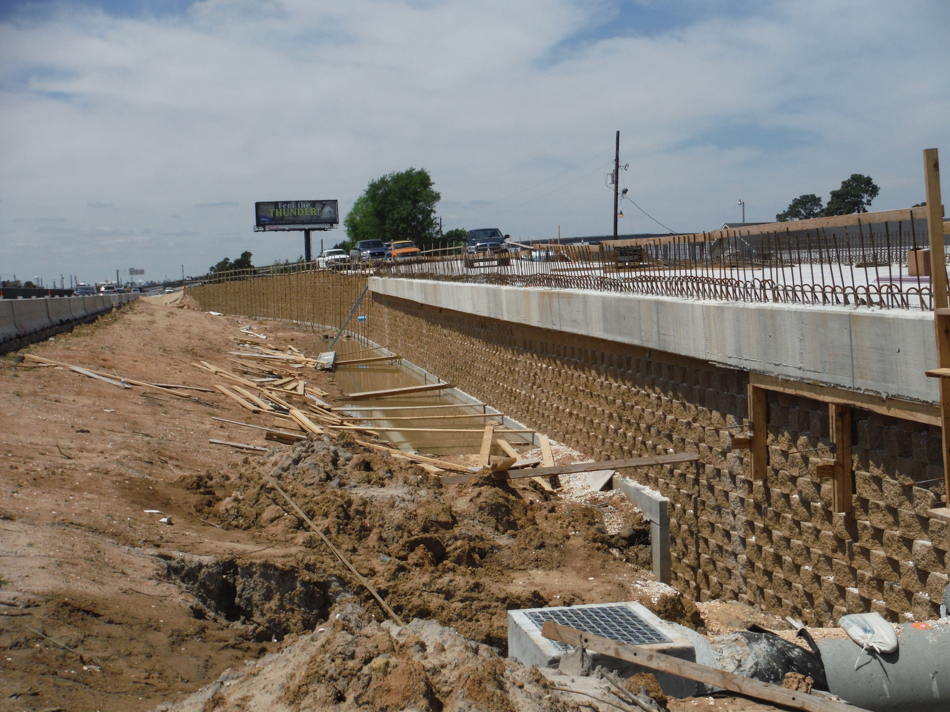
Top of MSE Walls

Slide 34
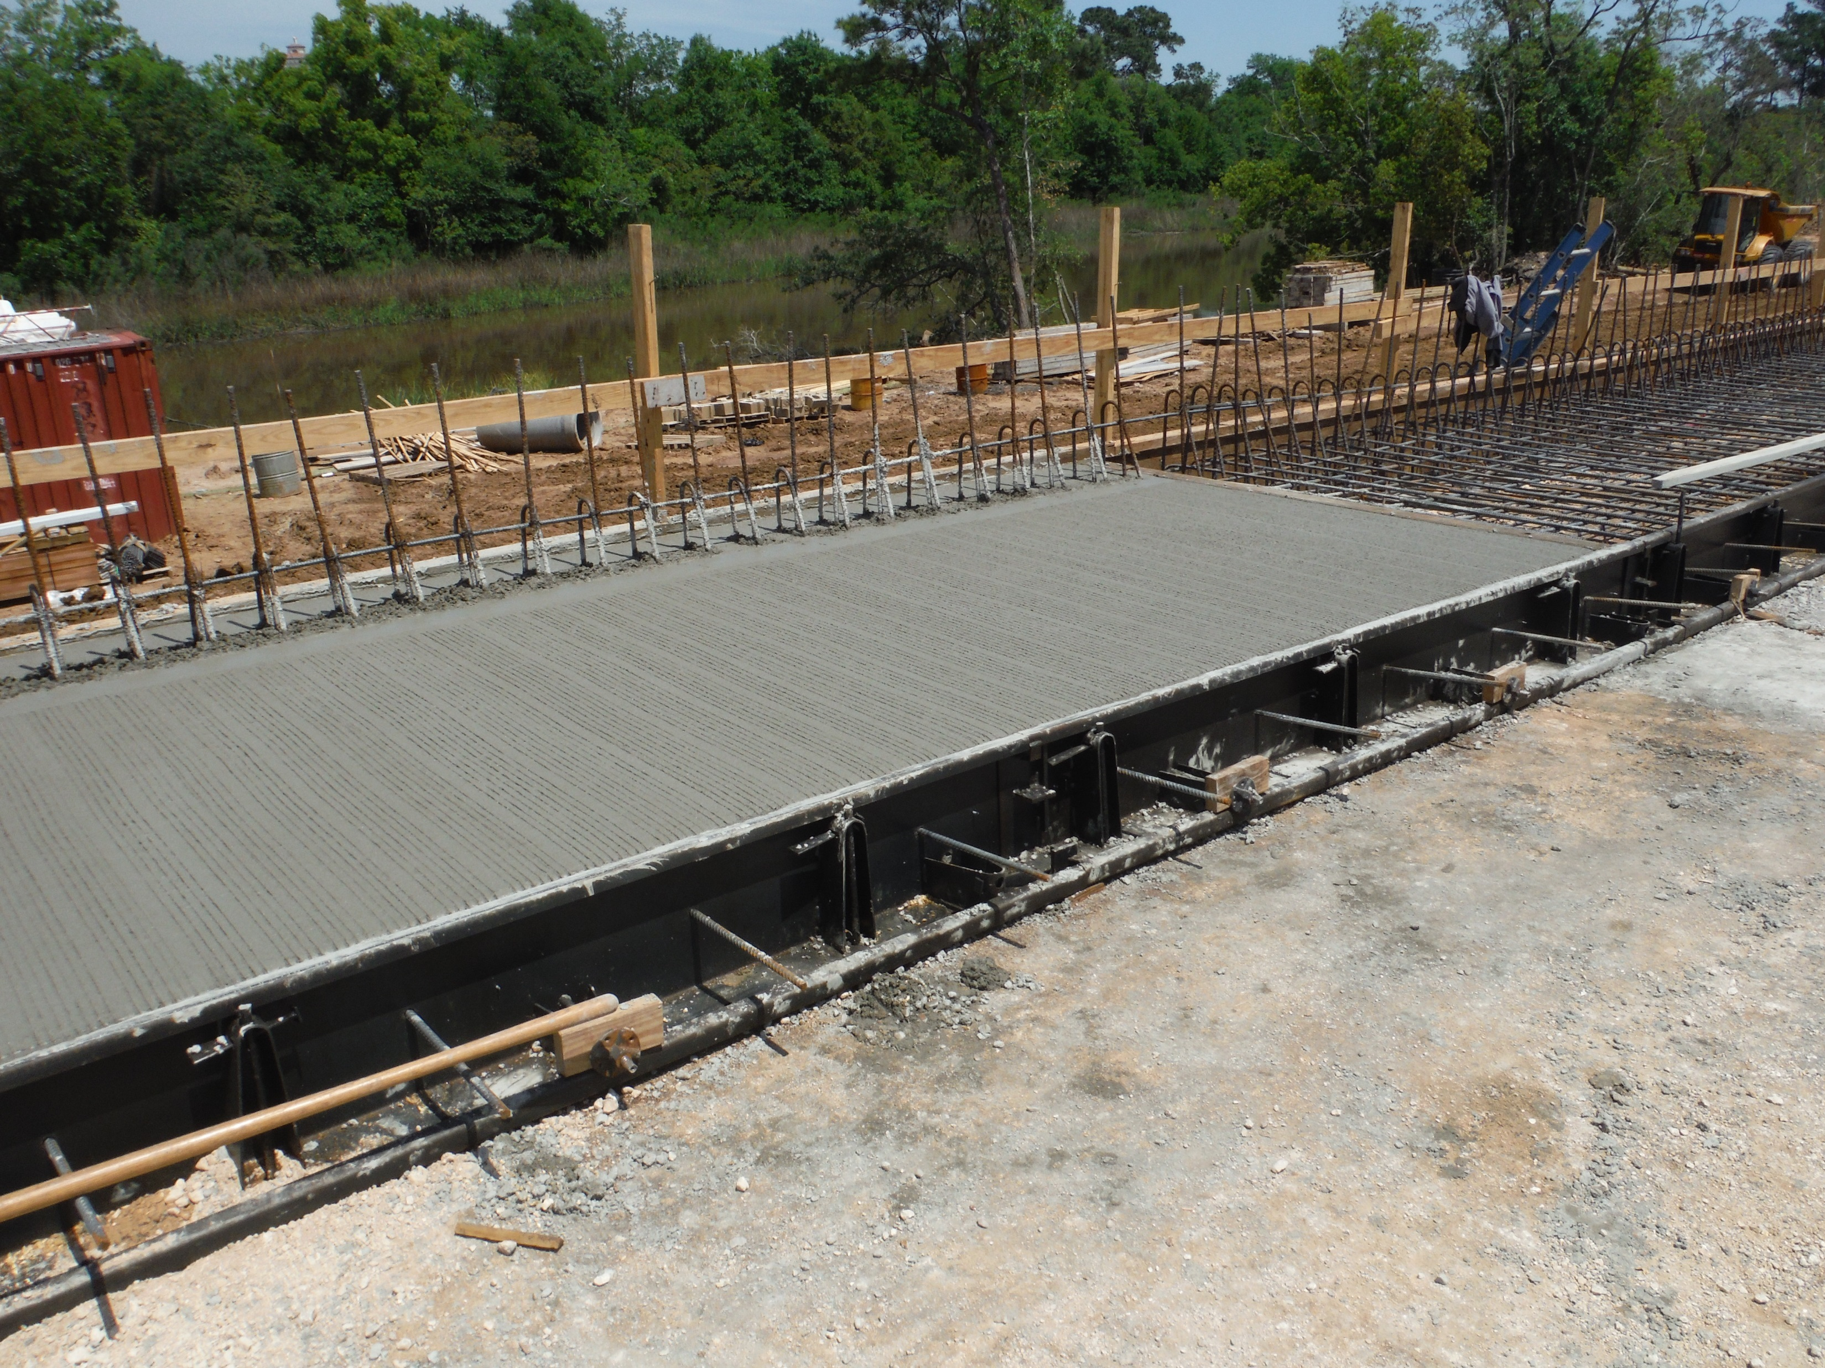
Top of MSE Walls

Slide 35
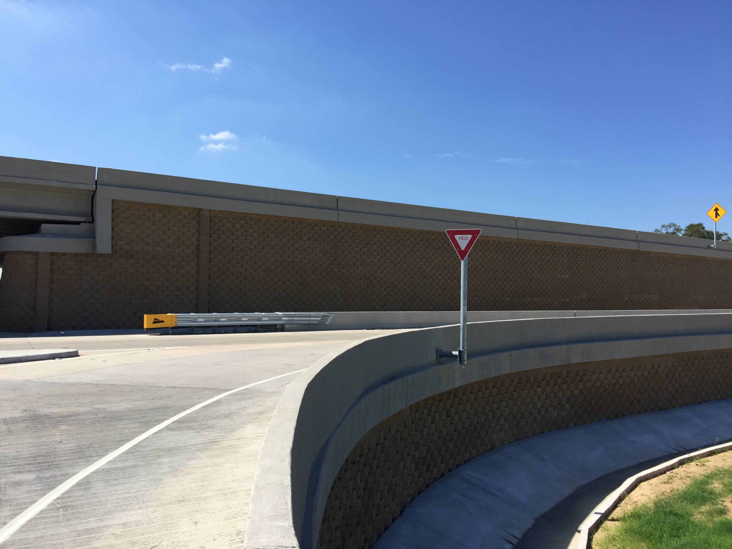
MSE Walls

Slide 36
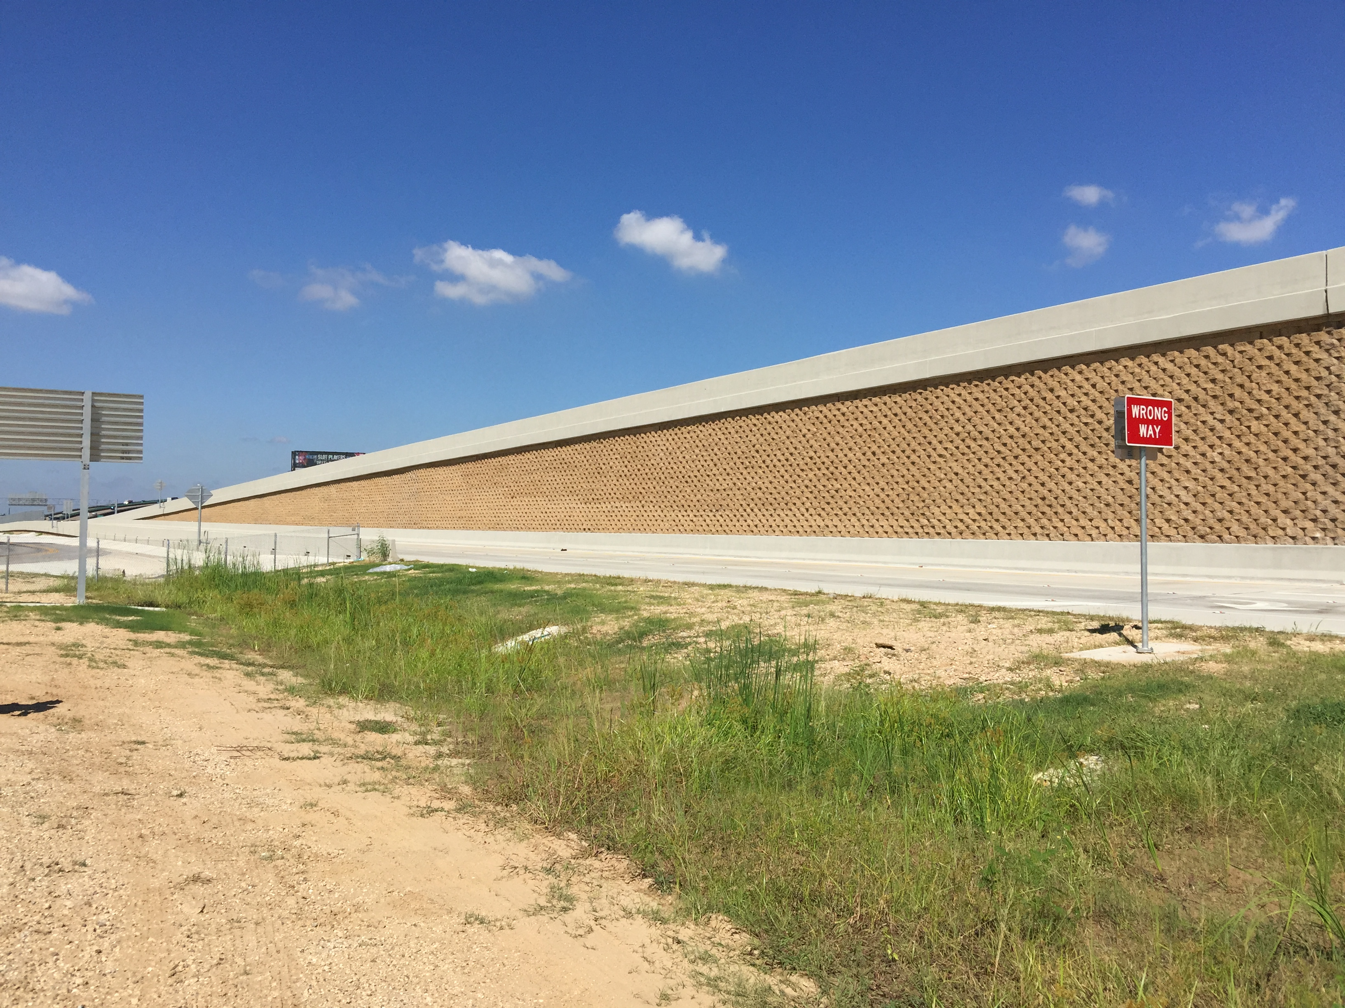
MSE Walls

Slide 37
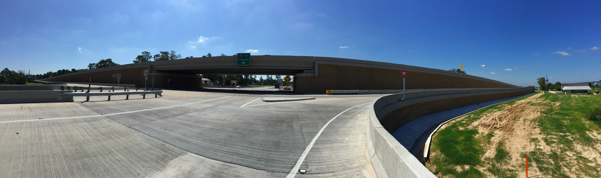
MSE Wall Summary
5,000 SF of Inextensible Steel Reinforced MSE Wall installed (includes Temp. Walls)
  Utilized to handle bridge support loads
  Minimized deformation
  100 year design life
127,000 SF of Extensible Geogrid Reinforced MSE Wall installed (includes Temp. Walls)
  Integrated look with inextensible walls at abutment
  Maximized construction efficiency and speed of installation
AASHTO LRFD Design Methodology

Slide 38
2016 Southeastern Transportation Geotechnical Engineering Conference
THANK YOU!
*Photo by GeoEngineers

